Slide 1
AP BIOLOGY SATURDAY ACADEMY
WELCOME!

Slide 2
Who am I?
Ms. Nicole DiLuglio
21st year of teaching-mostly in HISD
Currently teach at Sharpstown International School
Taught AP Biology for 10 years
Attended AP Biology reading in Kansas City
Biology major
I LOVE Biology!

Slide 3
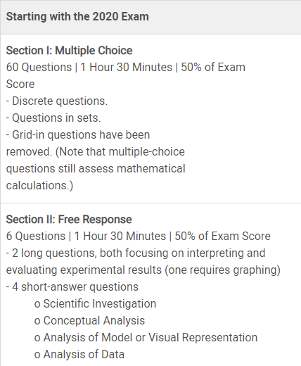
ABOUT THE AP BIOLOGY EXAM https://apcentral.collegeboard.org/courses/ap-biology?course=ap-biology

Slide 4
Overview of Semester 1:
Unit 0: Statistics, graphing, and
experimental design
Unit 1: Chemistry of Life
Unit 2: Cell Structure and Function
Unit 3: Cellular Energetics
Unit 4: Cell Communication and Cell Cycle

Slide 5
Unit 0: STATISTICS

Slide 6
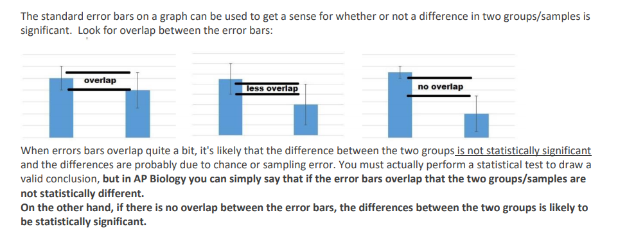
Standard Error of the Mean

Slide 7
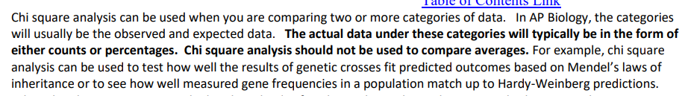
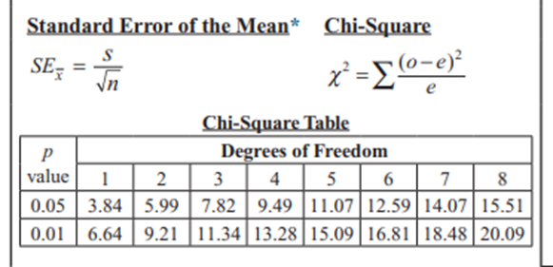
Chi Square Analysis

Slide 8
Unit 1: Chemistry of Life

Slide 9
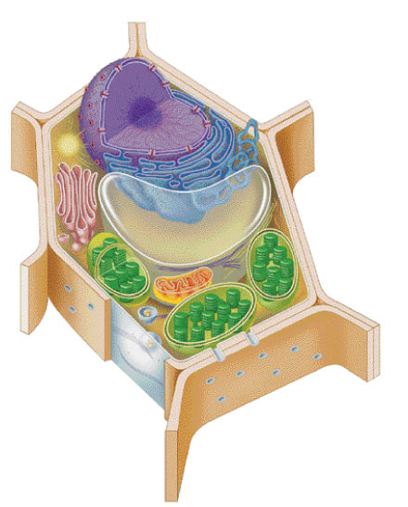
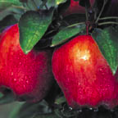
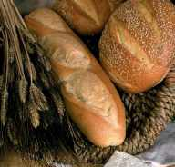
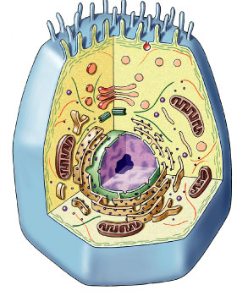
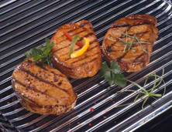
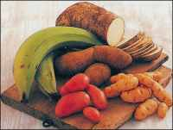
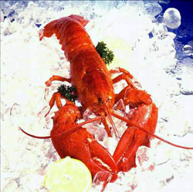
biomolecules

Slide 10
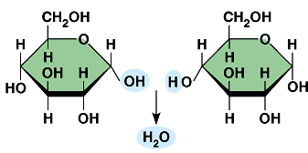
Carbohydrates
Structure / monomer
  monosaccharide
Function
  energy
  raw materials
  energy storage
  structural compounds
Examples
  glucose, starch, cellulose, glycogen
glycosidic bond

Slide 11
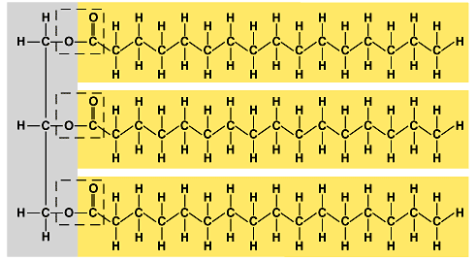
Lipids
Structure / building block
  glycerol, fatty acid, cholesterol, H-C chains
Function
  energy storage
  membranes
  hormones
Examples
  fat, phospholipids, steroids
ester bond (in a fat)

Slide 12
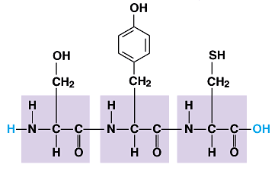
Proteins
Structure / monomer
  amino acids
  levels of structure
Function
  enzymes u defense
  transport u structure
  signals u receptors
Examples
  digestive enzymes, membrane channels, insulin hormone, actin
peptide bond

Slide 13
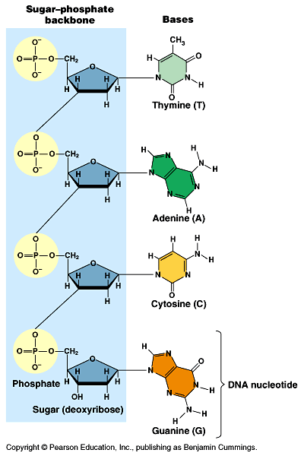
Nucleic acids
Structure / monomer
  nucleotide
Function
  information storage
  & transfer
Examples
  DNA, RNA
phosphodiester bond

Slide 14
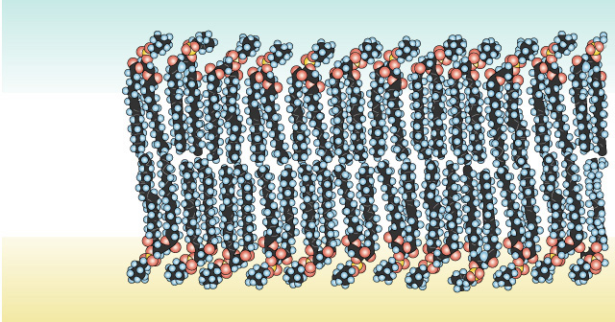
Arranged as a Phospholipid bilayer
Serves as a cellular barrier / border
sugar
H₂O
salt
polar
hydrophilic
heads
nonpolar
hydrophobic
tails
impermeable to polar molecules
polar
hydrophilic
heads
waste
lipids

Slide 15
Unit 2: Cell Structure and Function

Slide 16
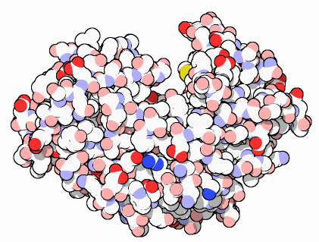
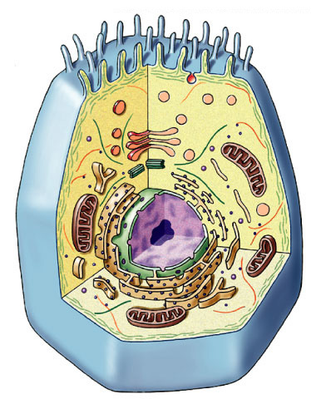
Proteins do all the work!
proteins
cells
DNA
Repeat after me…
Proteins do all the work!
organism

Slide 17
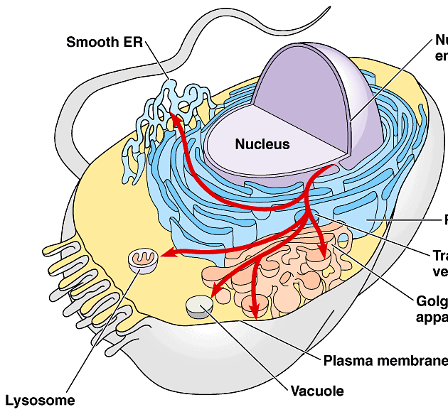
Building Proteins
Organelles involved
  nucleus
  ribosomes
  endoplasmic reticulum
  (ER)
  Golgi apparatus
  vesicles
The Protein Assembly Line
Golgi
apparatus
nucleus
ribosome
ER
vesicles

Slide 18
Membrane Factory
Build new membrane
  synthesize phospholipids
    builds membranes
  ER membrane expands
    bud off & transfer to other parts of cell that need membranes

Slide 19
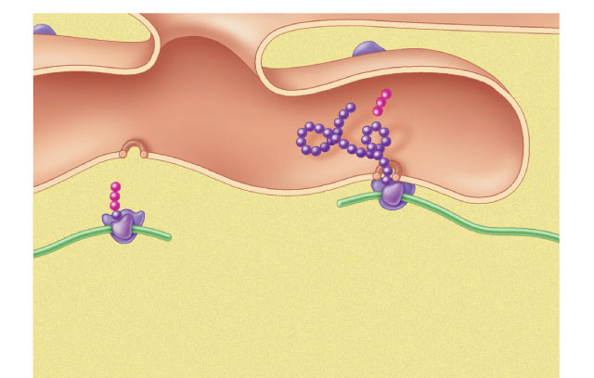
Synthesizing proteins
cisternal
space
polypeptide
signal
sequence
ribosome
ribosome
membrane of
endoplasmic reticulum
mRNA
cytoplasm

Slide 20
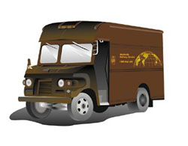
endoplasmic
reticulum
nucleus
DNA
protein
on its way!
TO:
RNA
vesicle
TO:
TO:
vesicle
ribosomes
TO:
protein
finished
protein
Golgi
apparatus
Making Proteins

Slide 21
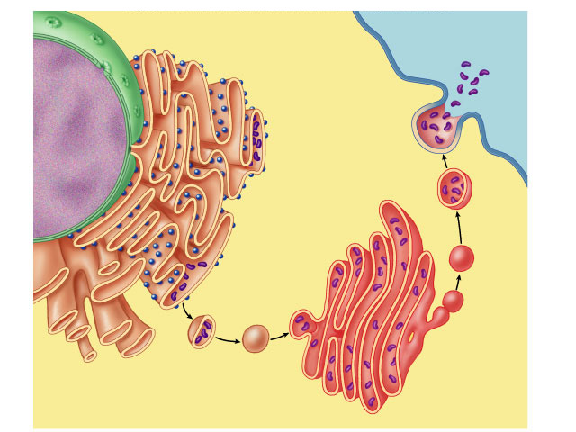
Making proteins
Putting it together…
nucleus
cell
membrane
nuclear pore
protein secreted
rough ER
ribosome
vesicle
proteins
smooth ER
transport
vesicle
Golgi
apparatus
cytoplasm

Slide 22
Unit 3: Cellular Energetics

Slide 23
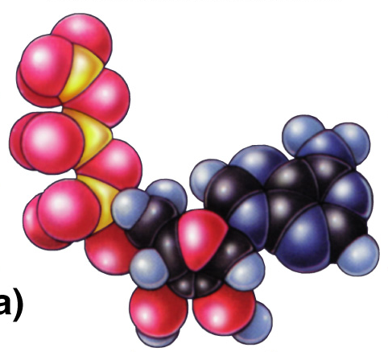
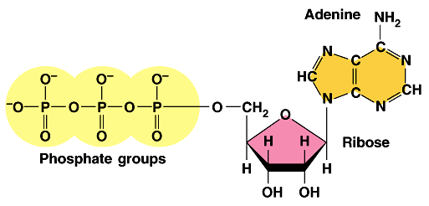
ATP
Adenosine TriPhosphate
  modified nucleotide
    nucleotide =
    adenine + ribose + P_{i} → AMP
    AMP + P_{i} → ADP
    ADP + P_{i} → ATP
  adding phosphates is endergonic
How efficient!
Build once,
use many ways
high energy bonds
Notes:
Marvel at the efficiency of biological systems!
Build once = re-use over and over again.
Start with a nucleotide and add phosphates to it to make this high energy molecule that drives the work of life.
Let’s look at this molecule closer.
Think about putting that Pi on the adenosine-ribose ==>
EXERGONIC or ENDERGONIC?

Slide 24
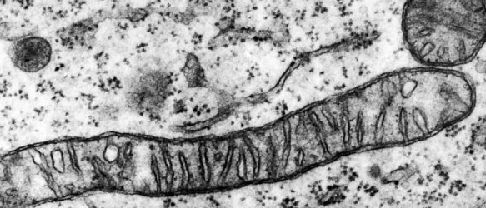
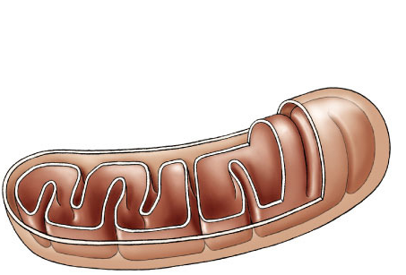

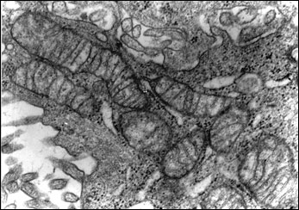
Mitochondria — Structure
Double membrane energy harvesting organelle
  smooth outer membrane
  highly folded inner membrane
    cristae
  intermembrane space
    fluid-filled space between membranes
  matrix
    inner fluid-filled space
  DNA, ribosomes
  enzymes
    free in matrix & membrane-bound
outer
membrane
intermembrane
space
inner
membrane
cristae
matrix
What cells would have a lot of mitochondria?
mitochondrial
DNA

Slide 25
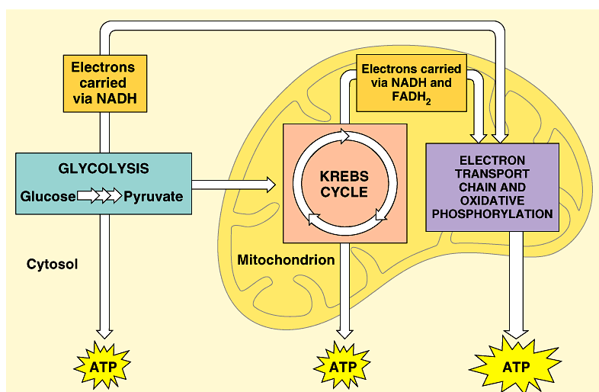
Overview of cellular respiration
4 metabolic stages
  Anaerobic respiration
    1. Glycolysis
      respiration without O₂
      in cytosol
  Aerobic respiration
      respiration using O₂
      in mitochondria
    2. Pyruvate oxidation
    3. Krebs cycle
    4. Electron transport chain
C₆H₁₂O₆
+
6O₂
→
ATP
+
6H₂O
+
6CO₂
(+ heat)

Slide 26
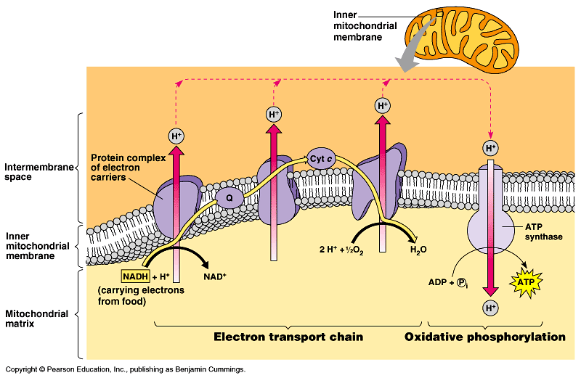

But what “pulls” the
electrons down the ETC?
H₂O
O₂
electrons
flow downhill
to O₂
oxidative phosphorylation
Notes:
Pumping H+ across membrane … what is energy to fuel that?
Can’t be ATP!
that would cost you what you want to make!
Its like cutting off your leg to buy a new pair of shoes. :-(
Flow of electrons powers pumping of H⁺
O₂ is 2 oxygen atoms both looking for electrons

Slide 27
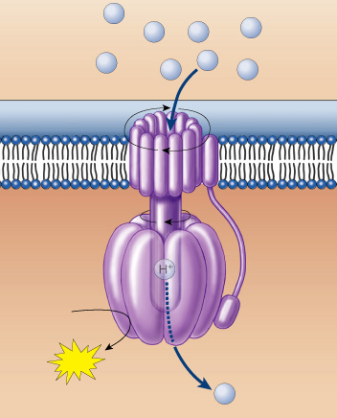
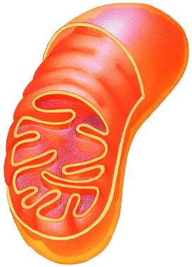
ATP synthase
H⁺
H⁺
H⁺
H⁺
H⁺
H⁺
H⁺
H⁺
Enzyme channel in mitochondrial membrane
  permeable to H⁺
  H⁺ flow down
  concentration gradient
    flow like water over
    water wheel
    flowing H+ cause
    change in shape of
    ATP synthase enzyme
    powers bonding of
    P_{i} to ADP:
    ADP + P_{i} → ATP
rotor
rod
catalytic
head
ADP
+
P
ATP
H⁺
But… How is the proton (H⁺) gradient formed?

Slide 28
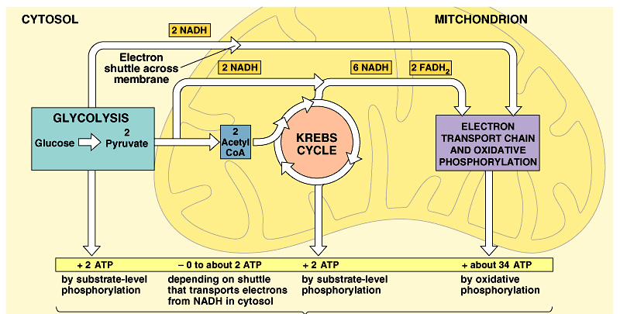
Cellular respiration
~40 ATP
2 ATP
+
2 ATP
+
~36 ATP

Slide 29
Summary of cellular respiration
C₆H₁₂O₆
+
6O₂
→
6CO₂
+
6H₂O
+
~40 ATP
Where did the glucose come from?
Where did the O₂ come from?
Where did the CO₂ come from?
Where did the CO₂ go?
Where did the H₂O come from?
Where did the ATP come from?
What else is produced that is not listed
in this equation?
Why do we breathe?
Notes:
Where did the glucose come from?
from food eaten
Where did the O₂ come from?
breathed in
Where did the CO₂ come from?
oxidized carbons cleaved off of the sugars (Krebs Cycle)
Where did the CO₂ go?
exhaled
Where did the H₂O come from?
from O₂ after it accepts electrons in ETC
Where did the ATP come from?
mostly from ETC
What else is produced that is not listed in this equation?
NAD, FAD, heat!

Slide 30
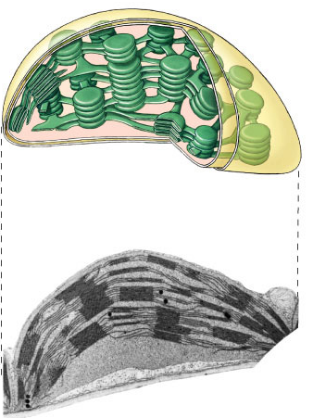
Plant structure
chloroplast
H⁺
H⁺
H⁺
H⁺
H⁺
H⁺
H⁺
H⁺
H⁺
ATP
H⁺
H⁺
thylakoid
Chloroplasts
  double membrane
  stroma
    fluid-filled interior
  thylakoid sacs
  grana stacks
Thylakoid membrane contains
  chlorophyll molecules
  electron transport chain
  ATP synthase
    H⁺ gradient built up within thylakoid sac
outer membrane
inner membrane
stroma
thylakoid
granum
Notes:
A typical mesophyll cell has 30-40 chloroplasts, each about 2-4 microns by 4-7 microns long.
Each chloroplast has two membranes around a central aqueous space, the stroma.
In the stroma are membranous sacs, the thylakoids.
These have an internal aqueous space, the thylakoid lumen or thylakoid space.
Thylakoids may be stacked into columns called grana.

Slide 31
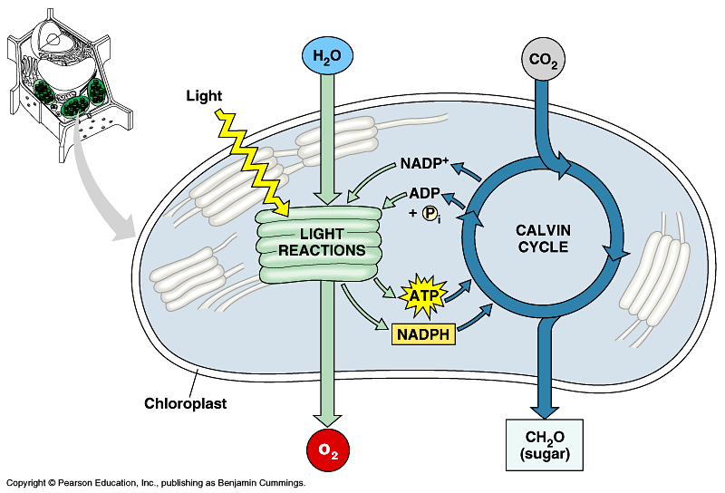

Photosynthesis
Light reactions
  light-dependent reactions
  energy conversion reactions
    convert solar energy to chemical energy
    ATP & NADPH
Calvin cycle
  light-independent reactions
  sugar building reactions
    uses chemical energy (ATP & NADPH) to reduce CO₂ & synthesize C₆H₁₂O₆
It’s not the
Dark Reactions!

Slide 32
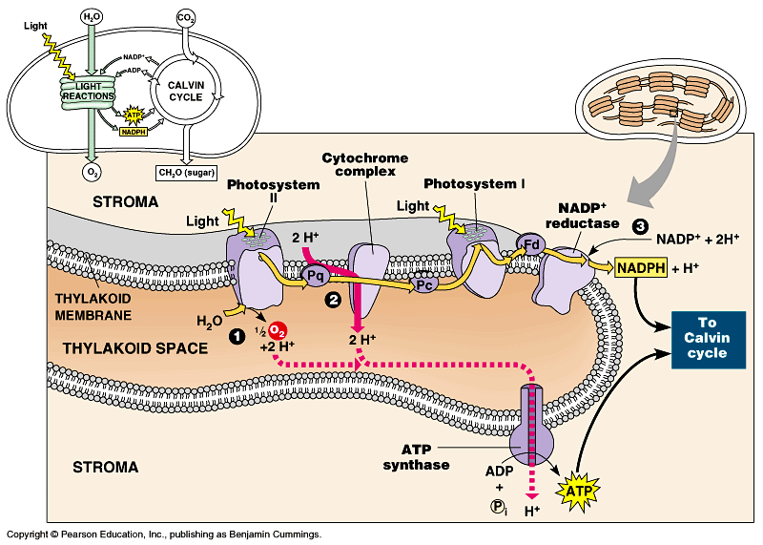
ETC of Photosynthesis
Chloroplasts transform light energy into chemical energy of ATP
  use electron carrier NADPH
generates O₂
Notes:
Two places where light comes in.
Remember photosynthesis is endergonic -- the electron transport chain is driven by light energy.
Need to look at that in more detail on next slide

Slide 33
Photosynthesis summary
Where did the energy come from?
Where did the electrons come from?
Where did the H₂O come from?
Where did the O₂ come from?
Where did the O₂ go?
Where did the H⁺ come from?
Where did the ATP come from?
What will the ATP be used for?
Where did the NADPH come from?
What will the NADPH be used for?
…stay tuned for the Calvin cycle
Notes:
Where did the energy come from? The Sun
Where did the electrons come from? Chlorophyll
Where did the H₂O come from?
The ground through the roots/xylem
Where did the O₂ come from? The splitting of water
Where did the O₂ go? Out stomates to air
Where did the H⁺ come from? The slitting of water
Where did the ATP come from?
Photosystem 2: Chemiosmosis (H+ gradient)
What will the ATP be used for?
The work of plant life! Building sugars
Where did the NADPH come from?
Reduction of NADP (Photosystem 1)
What will the NADPH be used for? Calvin cycle / Carbon fixation

Slide 34
Unit 4: Cell Communication and
THE CELL Cycle

Slide 35
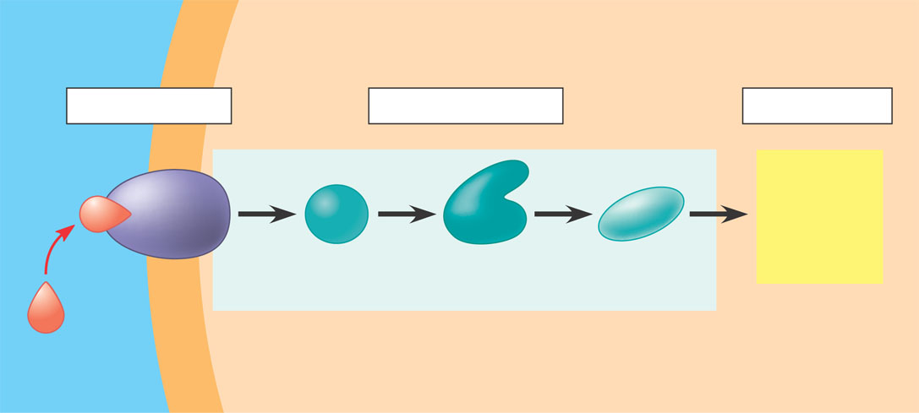
Overview of cell signaling
EXTRACELLULAR
FLUID
CYTOPLASM
Plasma membrane
1
Reception
2
Transduction
3
Response
Receptor
Activation
of cellular
response
Relay molecules in a signal transduction pathway
Signal
molecule
Figure 11.5

Slide 36
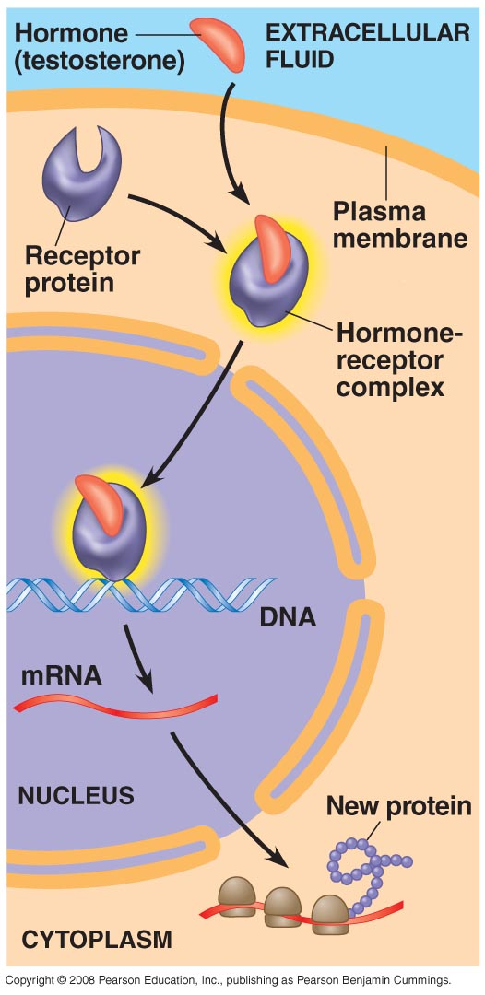

Slide 37
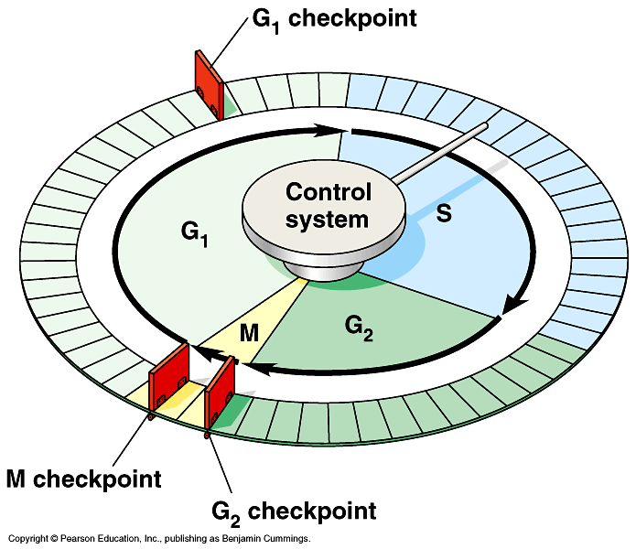
Checkpoint control system
Checkpoints
  cell cycle controlled by STOP & GO chemical signals at critical points
  signals indicate if key cellular
  processes have been
  completed correctly

Slide 38
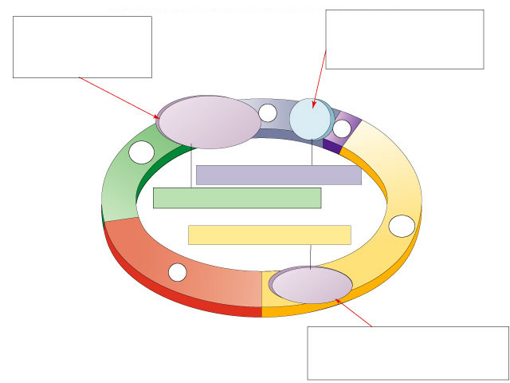
Spindle checkpoint
G₂ / M checkpoint
Chromosomes attached at metaphase plate
Replication completed
DNA integrity
Inactive
Active
Active
Inactive
Cdk / G₂
cyclin (MPF)
M
cytokinesis
APC
C
G₂
mitosis
G₁
S
Cdk / G₁
cyclin
MPF = Mitosis Promoting Factor
APC = Anaphase Promoting Complex
Inactive
Active
G₁ / S checkpoint
Growth factors
Nutritional state of cell
Size of cell

Slide 39
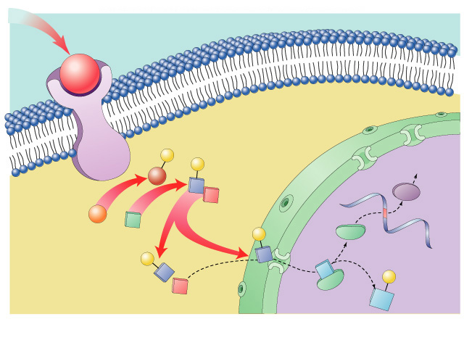
Growth factor signals
growth factor
nuclear pore
nuclear membrane
P
P
cell division
cell surface
receptor
Cdk
protein kinase
cascade
P
E2F
P
chromosome
Rb
E2F
P
cytoplasm
Rb
nucleus

