Slide 1
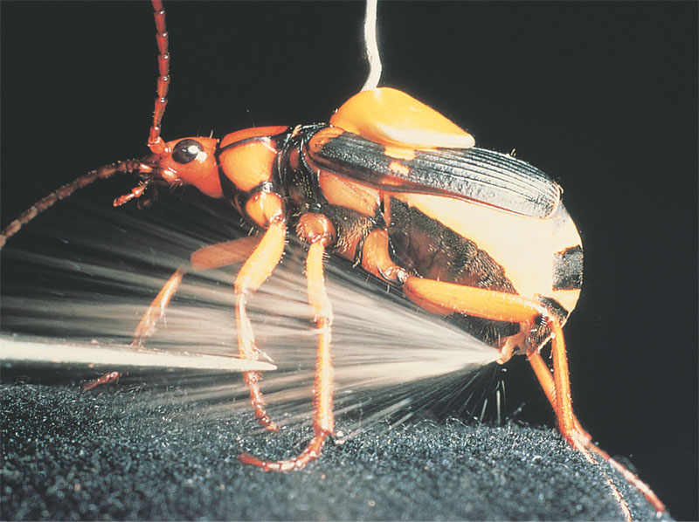
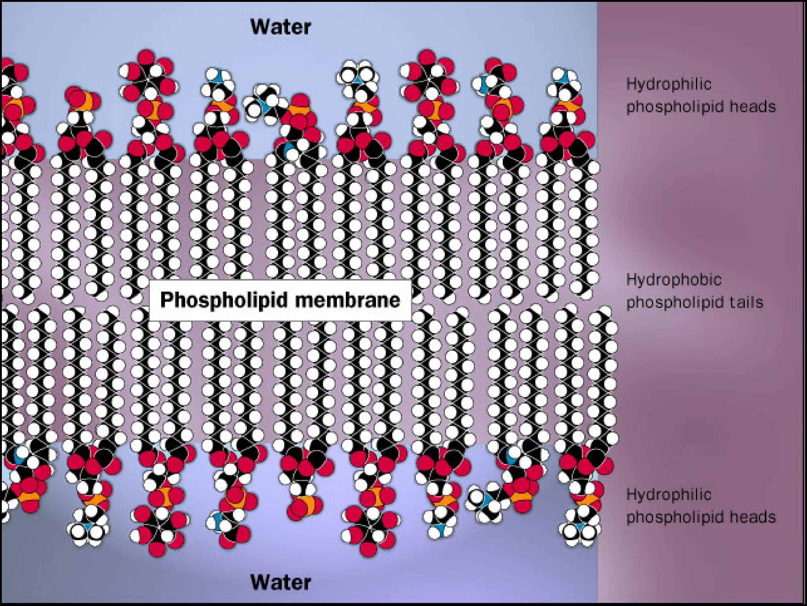
The Chemistry of Life

Slide 2
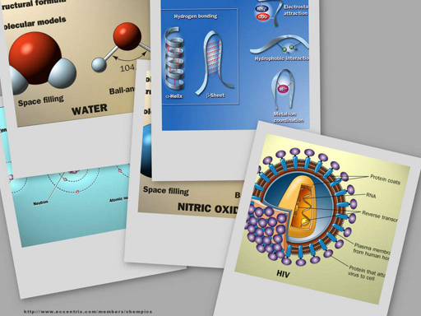
Why are we studying chemistry?
Chemistry is the foundation of Biology

Slide 3
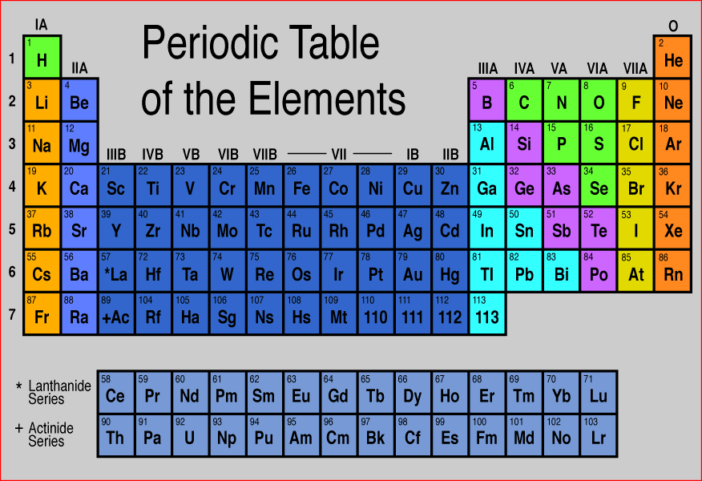
The World of Elements
H
C
N
O
Na
Mg
P
S
K
Ca
Notes:
About 25 elements are essential for life
Four elements make up 96% of living matter:
• carbon (C) • hydrogen (H)
• oxygen (O) • nitrogen (N)
Six elements make up most of remaining 4%:
• phosphorus (P) • calcium (Ca)
• sulfur (S) • potassium (K)
• magnesium (Mg) • sodium (Na)

Slide 4
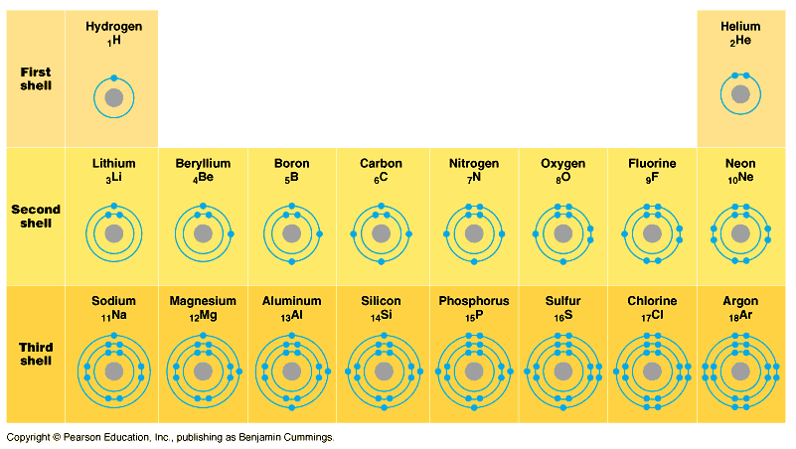
Elements & their valence shells
Elements in the same column have the same valence & similar chemical properties
Remember
some food chains are built on reducing O to H₂O
& some on
reducing S to H₂S
Notes:
ELECTRONEGATIVITY
Oxygen has medium electronegativity so doesn’t pull electrons all the way off hydrogen whereas chlorine would.
So oxygen forms a polar covalent bond.
Carbon has only a weak electronegativity so forms a nonpolar covalent bond

Slide 5
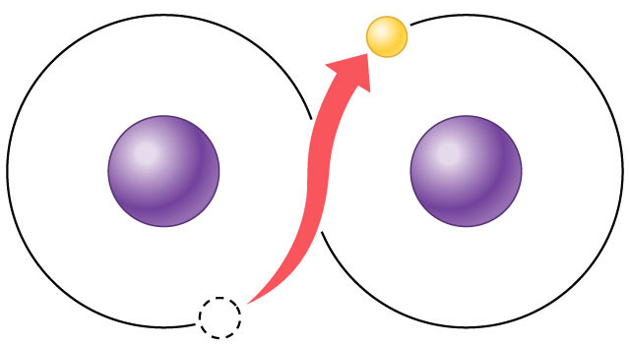
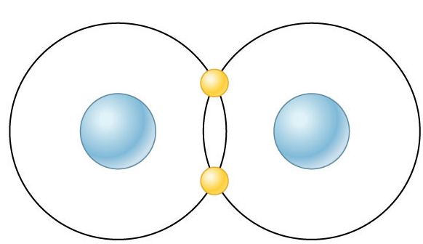
Chemical reactivity
Atoms tend to
complete a partially filled valence shell
or
empty a partially filled valence shell
This tendency drives chemical reactions…
and creates bonds
–
–
–
Notes:
Ionic or Covalent bonds

Slide 6
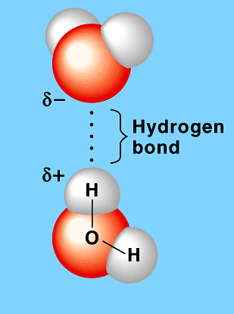
Bonds in Biology
Hydrogen bond
H₂O
Weak bonds
hydrogen bonds
attraction between + and –
hydrophobic & hydrophilic interactions
interactions with H₂O
van derWaals forces
ionic
Strong bonds
covalent bonds
sharing electrons
H₂O
Covalent bond
–
–
H₂ (hydrogen gas)

Slide 7
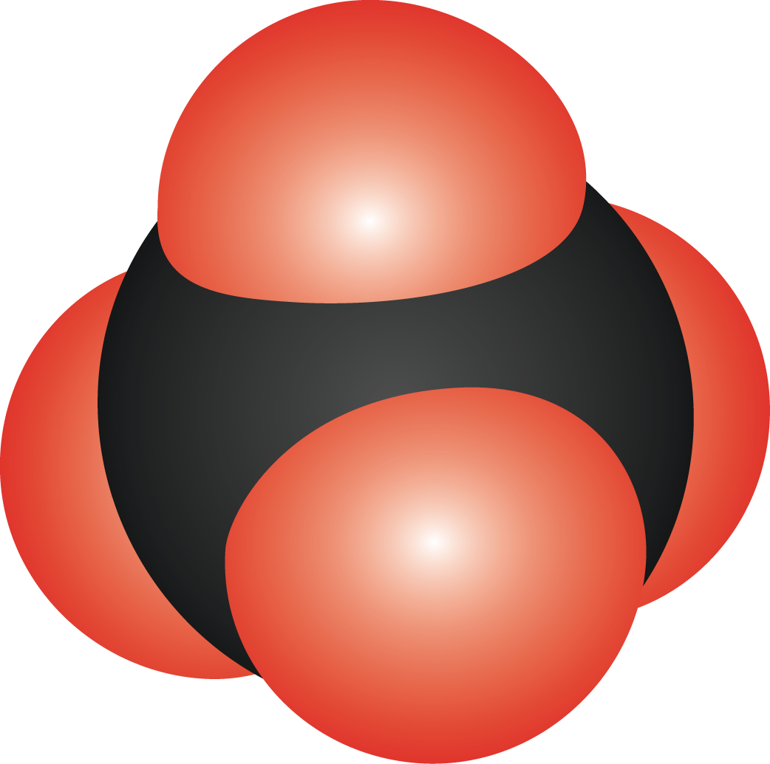
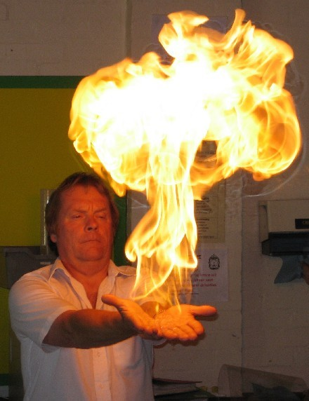
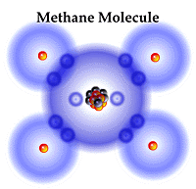
Nonpolar covalent bond
Pair of electrons shared equally by 2 atoms
example: hydrocarbons = C_{x}H_{x}
methane (CH₄ )
Lots of energy stored… & released
balanced, stable, good building block
Notes:
Pair of electrons shared equally by 2 atoms
strong stable bond
example: hydrocarbons = C_{x}H_{x}
methane (CH₄ )

Slide 8
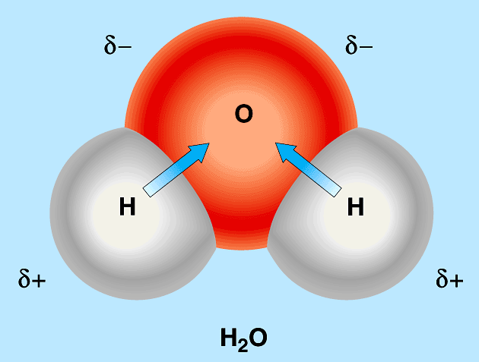
Polar covalent bonds
Pair of electrons shared unequally by 2 atoms
example: water = H₂O
oxygen has stronger “attraction” for the electrons than hydrogen
oxygen has higher electronegativity
water is a polar molecule
+ vs – poles
leads to many interesting properties of water…
+
–
H
–
Oxygen
H
–
+
–
Notes:
Pair of electrons shared unequally by 2 atoms
strong but interactive bond
example: bonds within water = H₂O
oxygen has stronger “attraction” for the electrons than hydrogen
oxygen has higher electronegativity
water is a polar molecule
+ vs – poles
leads to many interesting properties of water…

Slide 9
Hydrogen bonding
Polar water creates molecular attractions
attraction between positive H in one H₂O molecule to negative O in another H₂O
also can occur wherever an -OH exists in a larger molecule
Weak bond
but common in biology
H bonds
H
H
O
Notes:
APBio/TOPICS/Biochemistry/MoviesAP/03_02WaterStructure_A.swf
attraction between H+ in one molecule to O- in another molecule
weak bond
example: bonds between water molecules
leads to many interesting properties of water

Slide 10
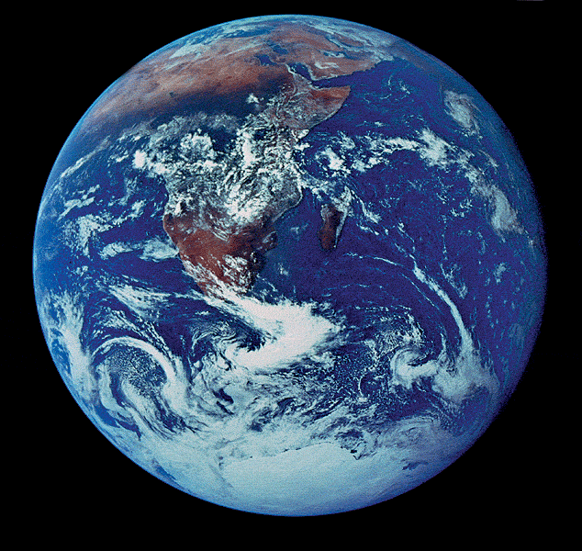
Chemistry of Life
Properties of Water

Slide 11
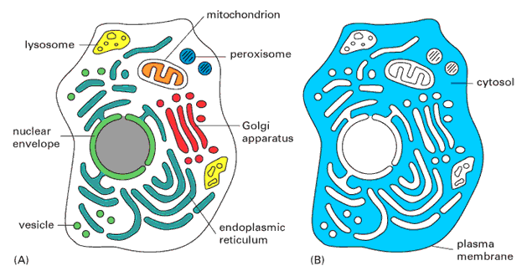
More about Water
Why are we studying water?
All life occurs in water
inside & outside the cell

Slide 12
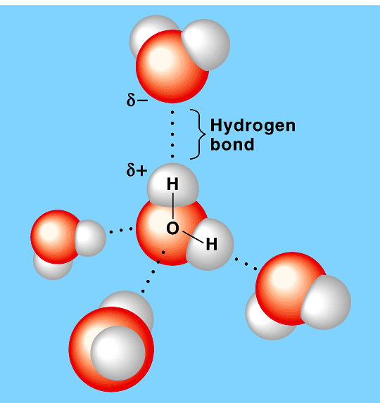
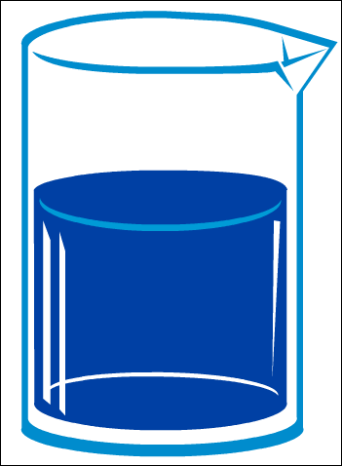
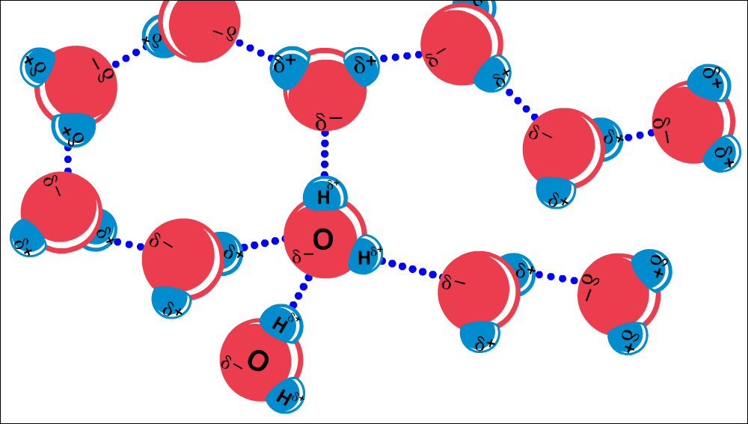
Chemistry of water
H₂O molecules form H-bonds with each other
+H attracted to –O
creates a sticky molecule
Notes:
APBio/TOPICS/Biochemistry/Movies AP/hydrogenbonds-Thinkwell.swf

