Slide 1
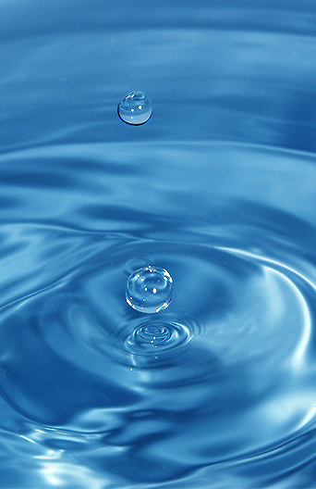
Elixir of Life
Special properties of water
1. cohesion & adhesion
surface tension, capillary action
2. good solvent
many molecules dissolve in H₂O
hydrophilic vs. hydrophobic
3. lower density as a solid
ice floats!
4. high specific heat
water stores heat
5. high heat of vaporization
heats & cools slowly
Ice! I could use more ice!

Slide 2
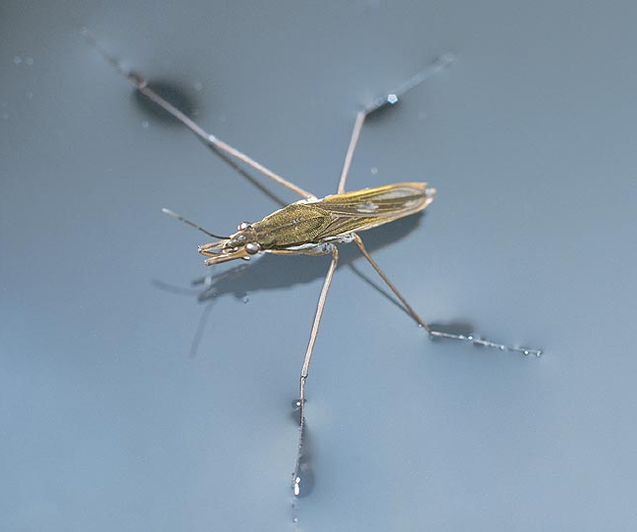
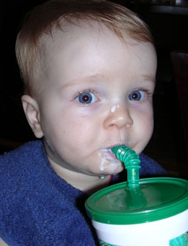
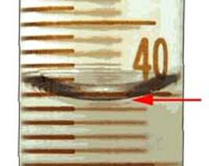
1. Cohesion & Adhesion
Cohesion
H bonding between H₂O molecules
water is “sticky”
surface tension
drinking straw
Adhesion
H bonding between H₂O & other substances
capillary action
meniscus
water climbs up paper towel or cloth
Try that with flour… or sugar…
Notes:
Cohesion
H bonding between H₂O molecules
water is “sticky”
surface tension
capillary action
drinking straw
Adhesion
H bonding between H₂O & other substances
capillary action
meniscus
water climbs up paper towel or cloth

Slide 3
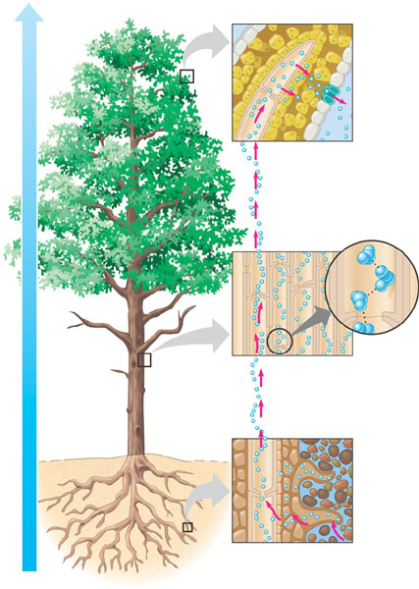
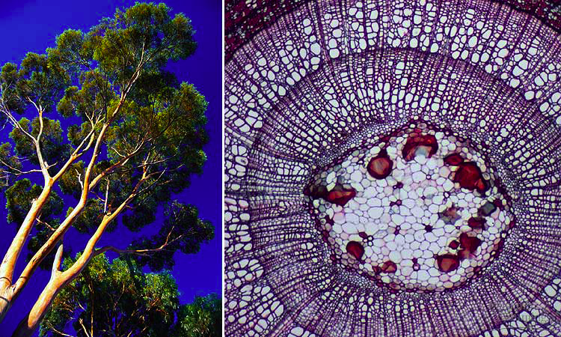
How does H₂O get to top of trees?
Transpiration is built on cohesion & adhesion
Notes:
APBio/TOPICS/04Biochemistry/MoviesAP/03_03WaterTransport_A.swf

Slide 4
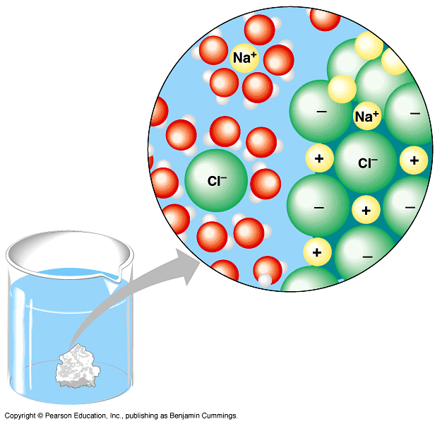
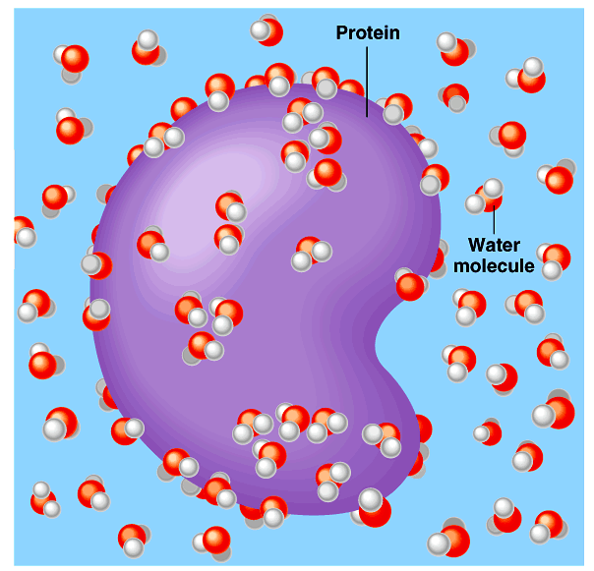
2. Water is the solvent of life
Polarity makes H₂O a good solvent
polar H₂O molecules surround + & – ions
solvents dissolve solutes creating solutions
Notes:
2. Water is a good solvent = the solvent of life
Polarity makes H₂O a good solvent
polar H₂O molecules surround + & – ions
solvents dissolve solutes creating solutions
What dissolves in water easily?
polar or non-polar molecules?
How about oxygen -- does that dissolve in H₂O?

Slide 5
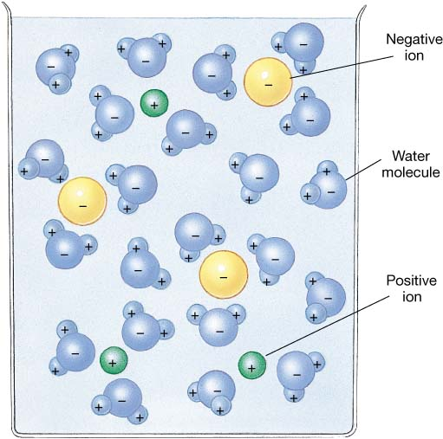
What dissolves in water?
Hydrophilic
substances have attraction to H₂O
polar or non-polar?
Notes:
Hydrophilic
substances have attraction to H₂O

Slide 6
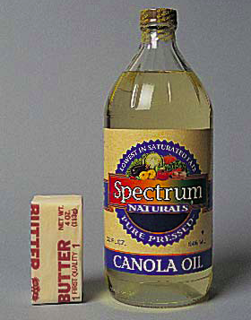
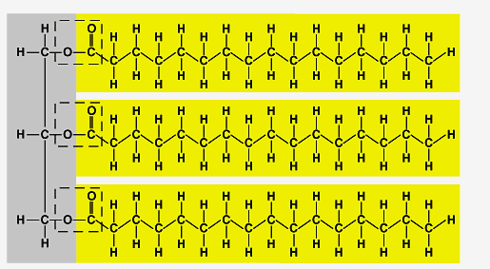
What doesn’t dissolve in water?
Hydrophobic
substances that don’t have an attraction to H₂O
polar or non-polar?
Oh, look hydrocarbons!
fat (triglycerol)
Notes:
Hydrophobic
substances that don’t have an attraction to H₂O

Slide 7
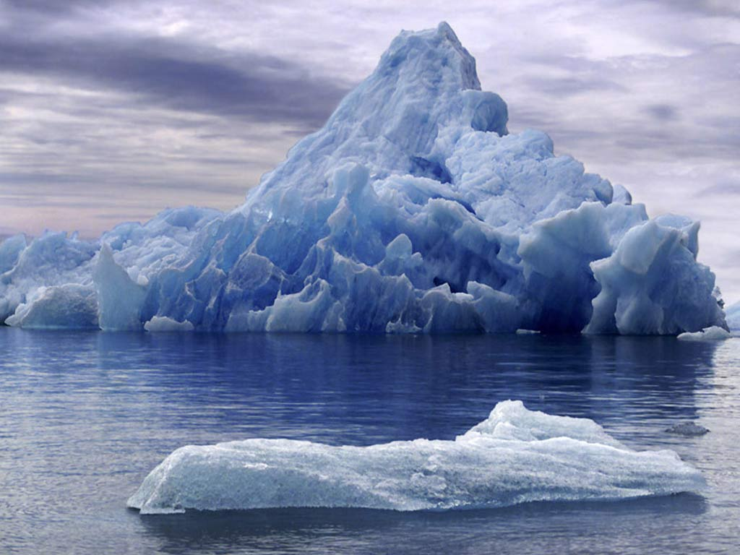
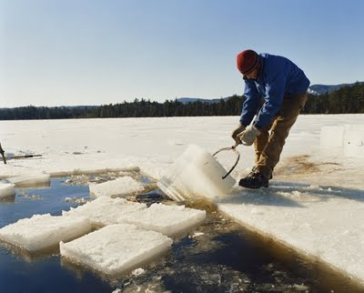
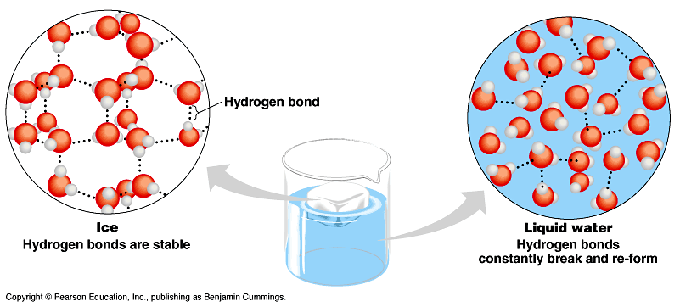
3. The special case of ice
Most (all?) substances are more dense when they are solid, but
not water…
Ice floats!
H bonds form a crystal
Ice! I could use more ice!
And this has made all the difference!
Notes:
Most (all?) substances are more dense when they are solid, but not water…
Lower density as a solid = Ice floats!
H bonds form a crystal

Slide 8
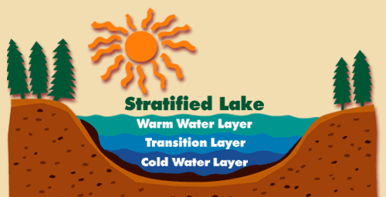
Why is “ice floats” important?
Oceans & lakes don’t freeze solid
surface ice insulates water below
allowing life to survive the winter
if ice sank…
ponds, lakes & even oceans would freeze solid
in summer, only upper few inches would thaw
seasonal turnover of lakes
sinking cold H₂O cycles nutrients in autumn
Notes:
Oceans & lakes don’t freeze solid
surface ice insulates water below
allowing life to survive the winter
if ice sank…
ponds, lakes & even oceans would freeze solid
in summer, only upper few inches would thaw
seasonal turnover of lakes
sinking cold H₂O cycles nutrients in autumn

Slide 9
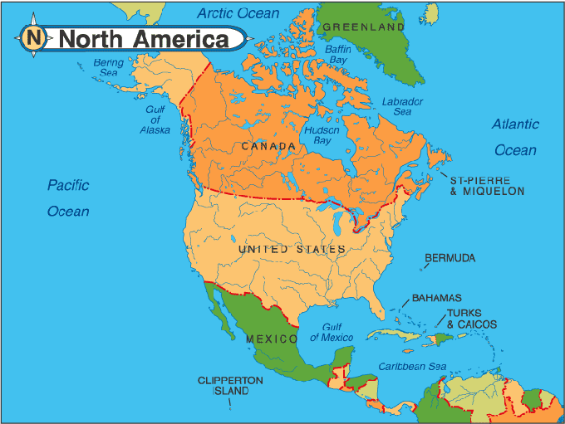
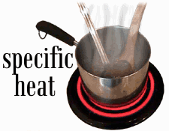
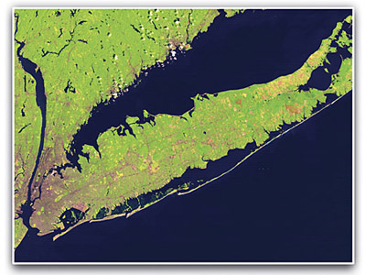
4. Specific heat
H₂O resists changes in temperature
high specific heat
takes a lot to heat it up
takes a lot to cool it down
H₂O moderates temperatures on Earth
Specific heat & climate
Notes:
Specific heat
H₂O resists changes in temperature
high specific heat = heats & cools slowly
takes a lot to heat it up
takes a lot to cool it down
H₂O moderates temperatures on Earth

Slide 10
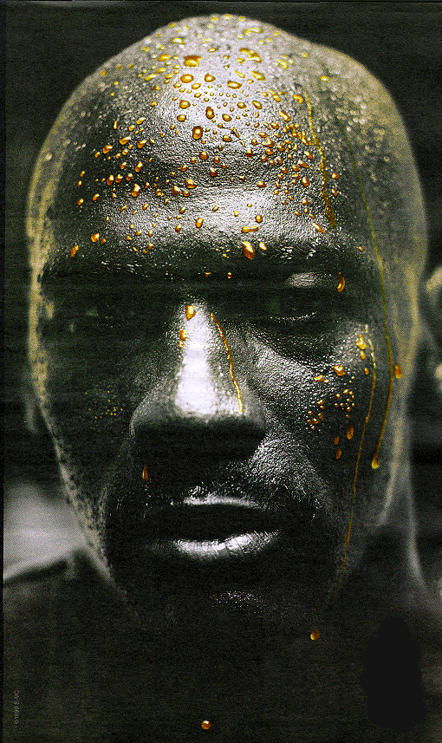
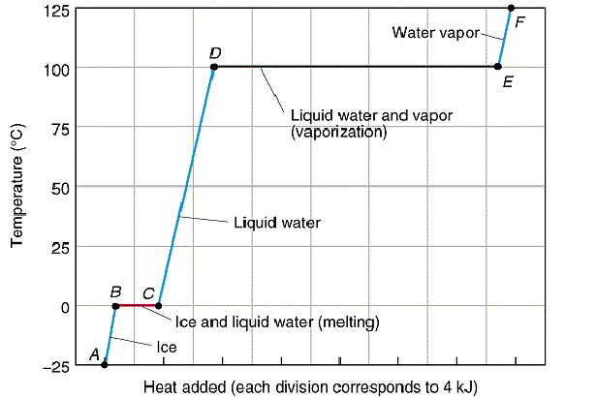
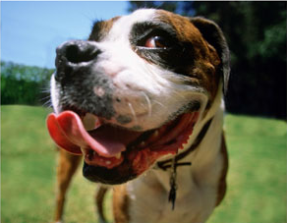
5. Heat of vaporization
Evaporative cooling
Organisms rely on heat of vaporization to remove body heat

Slide 11
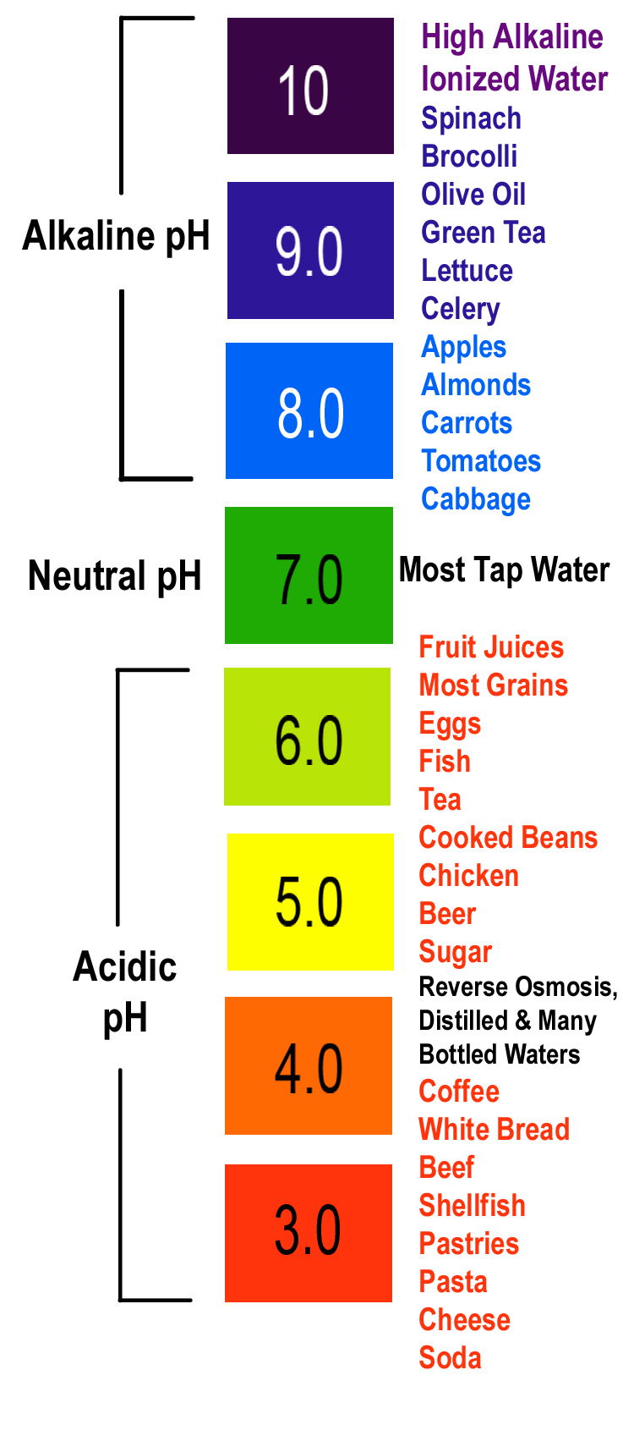
Ionization of water & pH
Water ionizes
H⁺ splits off from H₂O, leaving OH–
if [H⁺] = [⁻OH], water is neutral
if [H⁺] > [⁻OH], water is acidic
if [H⁺] < [⁻OH], water is basic
pH scale
how acid or basic solution is
1 → 7 → 14
H₂O → H⁺ + OH–
Notes:
Water ionizes
H⁺ splits off from H₂O, leaving OH–
H₂O → H⁺ + OH–
if [H⁺] = [⁻OH], water is neutral
if [H⁺] > [⁻OH], water is acidic
if [H⁺] < [⁻OH], water is basic
pH scale
how acid or basic solution is
1 → 7 → 14

Slide 12
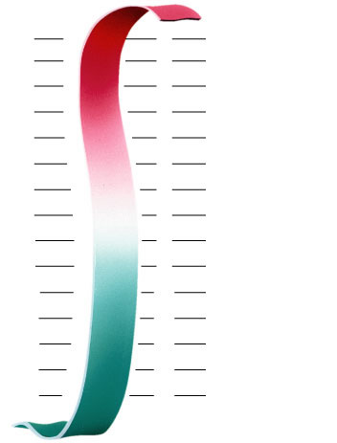
pH Scale
H⁺ Ion
Concentration
Examples of Solutions
pH
10⁰
0
Hydrochloric acid
10^{–1}
1
tenfold change in H+ ions
pH1 → pH2
10⁻¹ → 10⁻²
10 times less H⁺
pH8 → pH7
10⁻⁸ → 10⁻⁷
10 times more H⁺
pH10 → pH8
10⁻¹⁰ → 10⁻⁸
100 times more H⁺
10^{–2}
2
Stomach acid, Lemon juice
10^{–3}
3
Vinegar, cola, beer
10^{–4}
4
Tomatoes
10^{–5}
5
Black coffee, Rainwater
10^{–6}
6
Urine, Saliva
10^{–7}
7
Pure water, Blood
10^{–8}
8
Seawater
10^{–9}
9
Baking soda
10^{–10}
10
Great Salt Lake
10^{–11}
11
Household ammonia
10^{–12}
12
Household bleach
10^{–13}
13
Oven cleaner
10^{–14}
14
Sodium hydroxide
Notes:
In pure water only 1 water molecule in every 554 million is dissociated
tenfold change in H+ ions
pH1 → pH2
10⁻¹ → 10⁻²
10 times less H⁺
pH8 → pH7
10⁻⁸ → 10⁻⁷
10 times more H⁺
pH10 → pH8
10⁻¹⁰ → 10⁻⁸
100 times more H⁺

Slide 13
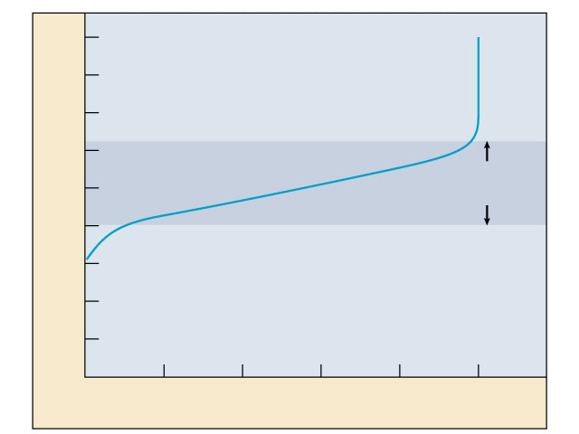
Buffers & cellular regulation
pH of cells must be kept ~7
pH affects shape of molecules
shape of molecules affect function
therefore pH affects cellular function
Control pH by buffers
reservoir of H⁺
donate H+ when [H⁺] falls
absorb H+ when [H⁺] rises
9
8
7
6
5
Buffering
range
pH
4
3
2
1
0
0
1
2
3
4
5
Amount of base added
Notes:
Exercise = acidic in muscles
CO₂ = carbonic acid
lactic acid
body uses buffers to counter act this

