Slide 1
Standard Error for AP Biology

Slide 2
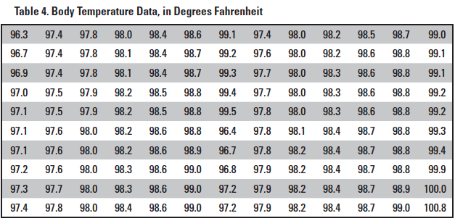
Statistics are helpful to better understand the meaning of a sample data set
What do these numbers actually MEAN?

Slide 3
Data analysis allows you to…
Arrive at conclusions about your data
Make claims about your data
Support arguments using your data
Estimate the reliability of your data
Effectively communicate conclusions about your work to a larger scientific community

Slide 4
Appropriate descriptive statistics for a data set typically include:
Mean (average)
Sample size
Standard deviation
Standard error

Slide 5
Mean (average)
Sum of the numbers in the sample divided by the total number in the sample
Summarizes the entire sample
Might provide an estimate of the entire population’s (that was sampled) true mean

Slide 6
Sample mean = 98.25 degrees F

Slide 7
Sample size
How many members of the population are included in the study
Important when determining confidence that analysis of sample set is representative of entire population
In formulas, sample size = n

Slide 8
Sample size= 130

Slide 9
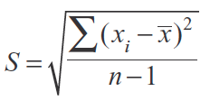
Standard deviation
Tool for measuring the spread (variance) in the sample population
Large standard deviation indicates that the data have a lot of variability
Small standard deviation indicates that the data are clustered close to the sample mean
You do NOT have to
calculate this on the
AP Biology Exam, but
you should understand
how it is derived and used.

Slide 10
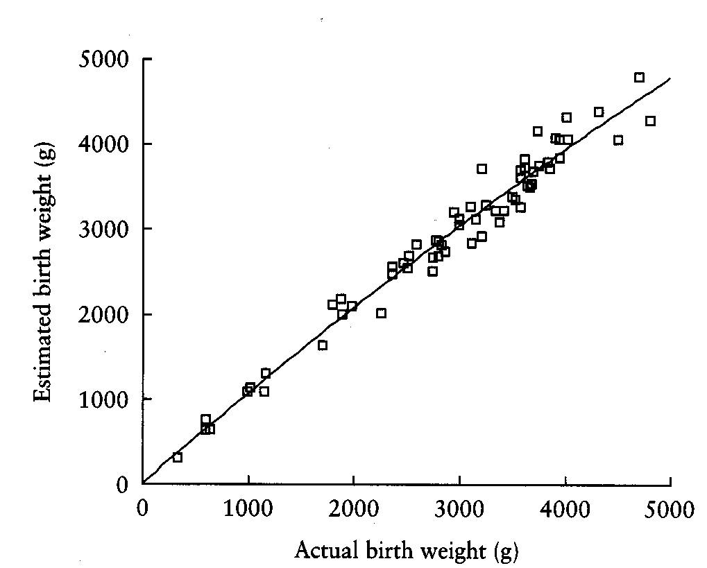
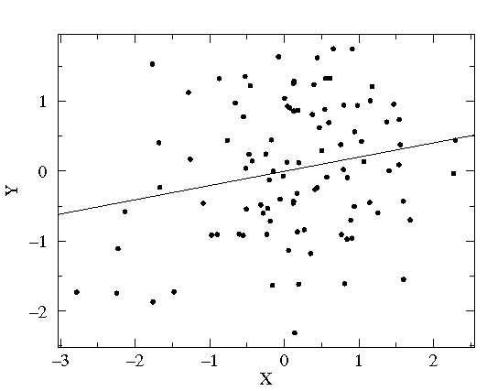
Large standard deviation
(spread out from mean)
Small standard deviation
(clustered close to mean)

Slide 11
Standard deviation = 0.73 deg. F

Slide 12
Standard Error
Allows you to infer how well the sample mean matches up to the true population mean
Helps you to determine confidence in the data collected in a sample
95% confidence interval = ± 2 SE
(Random sampling of the population should produce a mean
that falls within ± 2 SE 95% of the time.)
You do NOT have to
calculate this on the
AP Biology Exam, but
you should understand
how it is derived and used.

Slide 13
Standard error = 0.06 deg. F

Slide 14
What does this tell us about the data set?
Sample mean = 98.25°F
Standard error = 0.06°F
Sample mean ±2 SE = 98.25 ± 0.12°F
95% confidence interval = 98.13 to 98.37°F
The range for the sample mean does NOT include the commonly accepted population mean body temperature of 98.6°F
This suggests that there is a statistically significant difference between the mean of this sample and the mean of the entire population

Slide 15
Example Problem
A student noticed that the ivy leaves growing on the shady side of a building were larger than ivy leaves growing on the sunny side of the same building. The student collected and measured the maximum width, in centimeters, of 30 leaves from each habitat. Use statistical analysis to determine if it’s likely that there is a significant difference in leaf size between the shady and sunny ivy plants with 95% confidence (±2 SE).

Slide 16
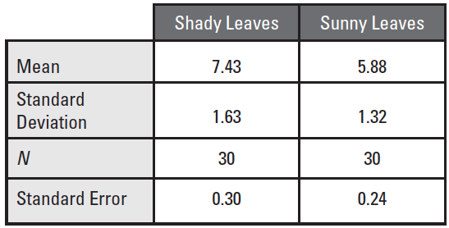
Collected Data

Slide 17
Collected Data
2 SE
95% confidence
0.60
0.48

Slide 18
Collected Data
Graph Mean
2 SE
0.60
0.48

Slide 19
Graph Means
7.43
5.88

Slide 20
Collected Data
2 SE
0.60
0.48
Add ± 2 SE Error Bars

Slide 21
Add ± 2 SE Error Bars
7.43 ± 0.60
5.88 ± 0.48

Slide 22
Conclusions
±2 SE Error bars (95% confidence intervals) do NOT overlap between sunny and shady means (7.43 - 0.60 > 5.88 + 0.48; 6.83 > 6.36)
Strongly suggests that the two populations are indeed statistically significantly different from one another
If the error bars/confidence intervals did overlap between the groups, you could not claim a statistically significant difference.

