Slide 1
The Biology of HIV
1.) The Emperor of All Maladies reading check
2.) Read and answer the “Introduction to the Viruses” handout and questions. Turn in your responses over the HUB or on paper before class is over today

Slide 2
Virus Review

Slide 5
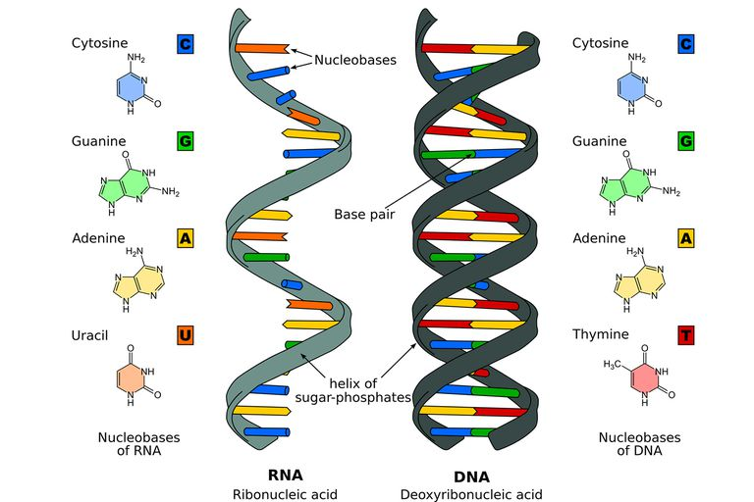

Slide 17
In your lab group, look over the HIV life cycle, discuss, and complete a written explanation of where medications might stop the progress of HIV infection.
Identify and write an explanation of at least FIVE and why medication would stop .

