Slide 1
Malaria
https://youtu.be/gwYIyjwYluc

Slide 2
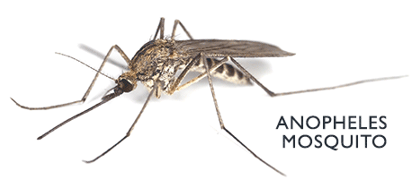

Slide 3
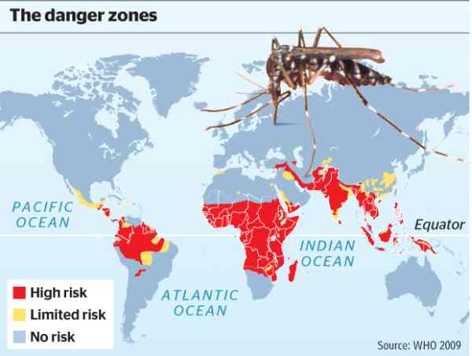

Slide 4
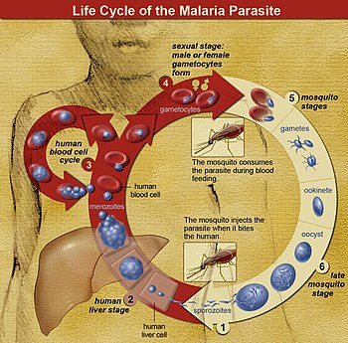

Slide 5
Symptoms of Malarial infection
Uncomplicated
Flu like symptoms
High fever
Malaise
Muscle aches
Headaches
Paroxysm ~ classic symptom
Severe
Organ Problems
Lungs- cannot breathe properly!
Circulatory- Low BP
Severe Anemia
Brain- coma

Slide 6
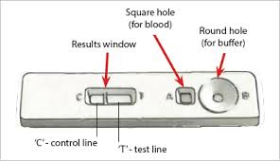
Diagnosis

Slide 7
Prevention

