Slide 1
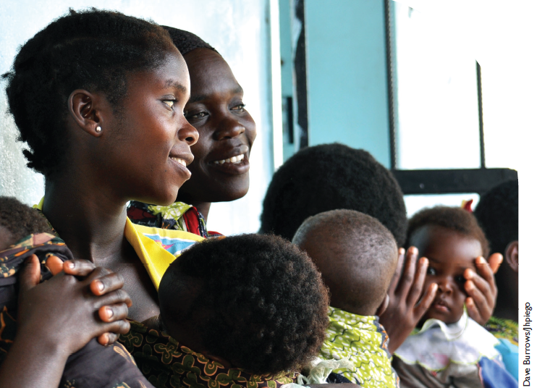
Maternal and child mortality

Slide 2
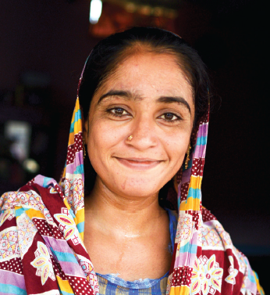
MaternaL Mortality
289,000 women worldwide die each year as a result of pregnancy and childbirth.
Most of these deaths are preventable
Most of these women live in poor nations, and the disparities are immense:
the lifetime risk of maternal mortality for a woman living in sub-Saharan Africa is over 47 times greater than for a woman living in the United States.

Slide 3
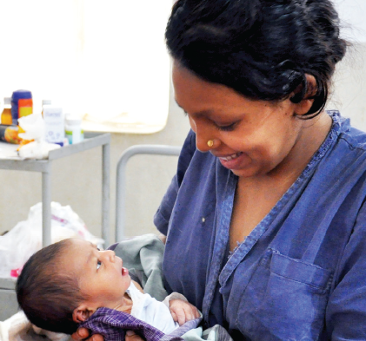
Maternal mortality
Key drivers of inequity in coverage and access to quality services may include:
poverty
cultural and gender norms
Age
Ethnicity
Religion
economic status
social stigma
geographical location

Slide 4
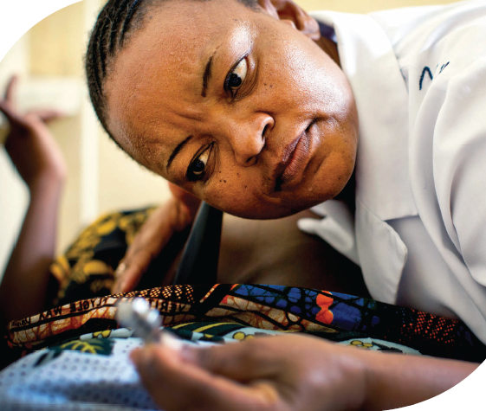
Preventable death and suffering persists due to a myriad of factors, including a failure to provide quality services and a woman’s lack of agency to utilize services

Slide 5
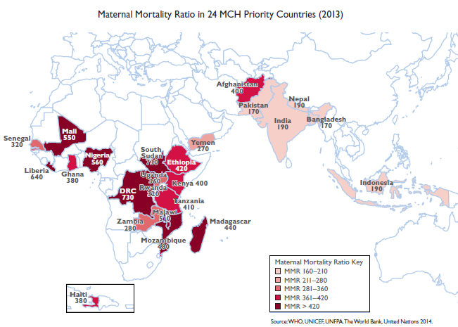

Slide 7
Main Causes of Maternal Death
obstetric hemorrhage (primarily postpartum)
severe pre-eclampsia :a condition of pregnancy characterized by high blood pressure(hypertension) and protein in the urine (proteinuria
Eclampsia: the development of seizures in a woman with severe preeclampsia. It has a 2% mortality (death) rate.
puerperal sepsis: any bacterial infection of the female reproductive tract following childbirth or miscarriage.Signs and symptoms usually include a fever greater than 38.0 °C (100.4 °F), chills, lower abdominal pain, and possibly bad-smelling vaginal discharge
unsafe abortion

Slide 8
Causes of Infant Mortality Worldwide
Globally, the top five causes of infant death in 2010
Neonatal encephalopathy -problems with brain function after birth. Neonatal encephalopathy usually results from birth trauma or a lack of oxygen to the baby during birth.
Infections, especially blood infections
Complications of preterm birth
Lower respiratory infections (such as flu and pneumonia)
Diarrheal diseases

Slide 9
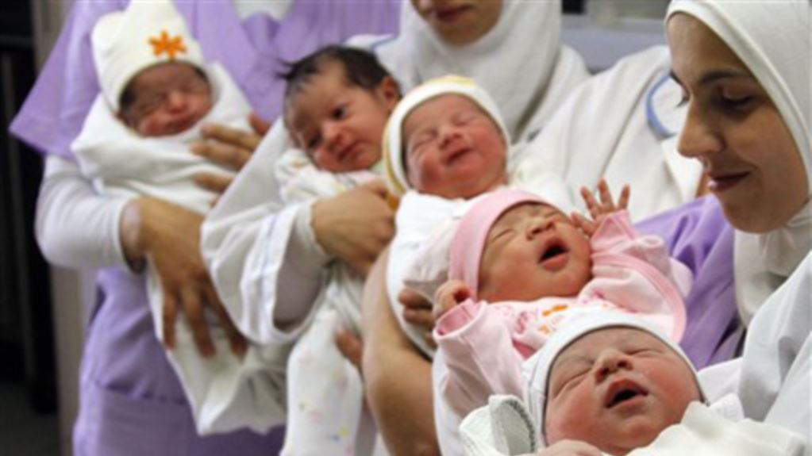
Infant mortality Situation and trends
In 2016, 4.2 million (75% of all under-five deaths) occurred within the first year of life.
The risk of a child dying before completing the first year of age was highest in the WHO African Region (52 per 1000 live births), over six times higher than that in the WHO European Region (8 per 1000 live births).
The infant mortality rate globally:
1990: 64.8 deaths per 1000 live births
2016: 30.5 deaths per 1000 live births
Annual infant deaths have declined from
8.8 million in 1990 to 4.2 million in 2016.

