Slide 1
Nitrogen Cycle
Objectives
To understand benefits of Nitrogen in biosphere
To analyze Nitrogen cycle
To evaluate consequences of disrupting the cycle

Slide 2
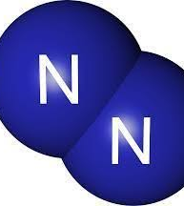
Nitrogen Cycle
https://youtu.be/ZaFVfHftzpI

Slide 3
Nitrogen Cycle

Slide 4
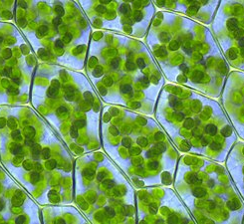
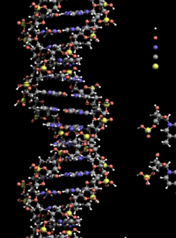
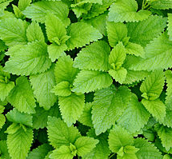
Nitrogen is useful how?
Everything that lives NEEDS Nitrogen
Amino acids
Proteins
DNA
ATP
Chlorophyll

Slide 6
Questions
Which is another method for fixing nitrogen?
What word describes the relationship between the plant and nitrogen-fixing bacteria?
What is Nitrogen used for in plants?
Which microorganism turns ammonia into nitrates?
In what form is nitrogen taken into a plant?
Where are nitrogen fixing bacteria found?

Slide 7
Excess of Nitrogen in environment is not good
CAUSES
Increased use of fertilizer by developed and developing countries
Combustion of fossil fuels
Burning of biomass
Gasoline powered vehicles
EFFECTS
Air pollution (Smog, acid rain)
Decreased visibility, health impacts
Eutrophication
Increase in greenhouse effect
Decrease in biodiversity

