Slide 1
Other Mechanisms of Evolution

Slide 2
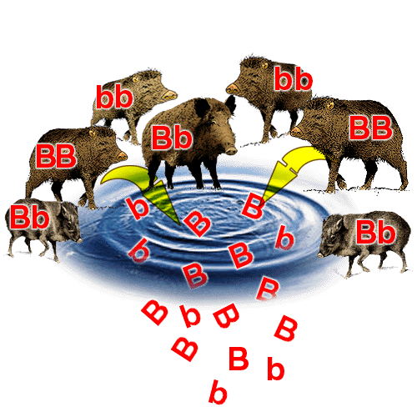
GENE POOL
All alleles that are present in a population.
In genetic terms, evolution is any change in the relative frequency of alleles in a population.

Slide 3
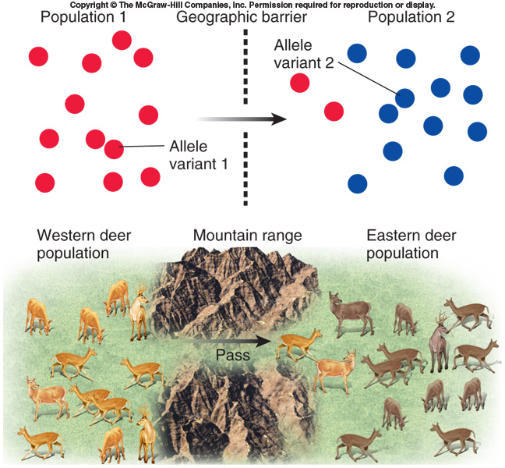
GENE FLOW
The movement of alleles in (immigration) and out (emigration) of a population.

Slide 4
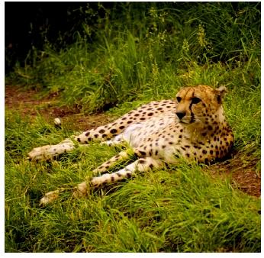
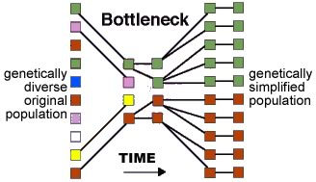
GENETIC DRIFT
A random change in allele frequency in a population.

Slide 5
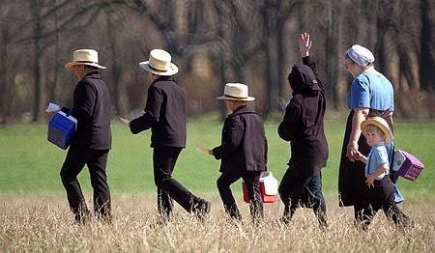
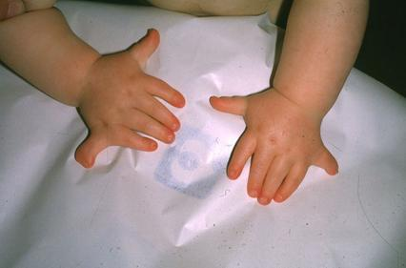
FOUNDER EFFECT
Change in allele frequencies as a result of the migration of a small subgroup of a population.
Ex: Ellis-van Creveld syndrome in the Amish.

Slide 6
http://www.youtube.com/watch?v=W-WumllRPLI
http://www.youtube.com/watch?v=Q6JEA2olNts
http://www.youtube.com/watch?v=WhFKPaRnTdQ
http://highered.mheducation.com/sites/dl/free/0072835125/126997/animation45.html

