Slide 1
AP Biology: Standard Deviation and Standard Error of the Mean
Carol Leibl
National Math and Science Initiative
Dallas, TX

Slide 2
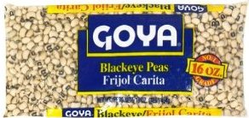
Sampling and Capturing the Actual Mean
Let’s suppose that 3 students are assigned to determine the mean of black-eyed peas from a 1 lbs. bag of black-eyes peas.
It would take hours to mass each and every pea. So the students decide to mass a random sample of the peas and determine the mean of the sample.

Slide 3
Standard Error or Standard Error of the Mean
It was agreed that each group would mass 100 black-eyed peas. The mean and standard deviation was determined for each of the three random samples.
All three means are different but certainly close. What is the probability that each group captured the actual mean?
Sample | Mean (g) | S
1 | 0.220 | 0.039
2 | 0.215 | 0.043
3 | 0.208 | 0.042

Slide 4
Standard Error or Standard Error of the Mean
A statistical computation that measures the probability of capturing the true mean of a population in a random sample is the standard error or standard error of the mean.
To compute the SE or SEM just simply divide the standard deviation by the square root of the number of data points.

Slide 5
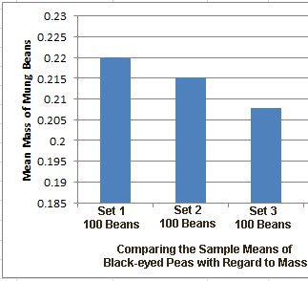
Mean
Sample | Mean (g) | SD | SE | 2 SE
1 | 0.220 | 0.039 | 0.0039 | 0.0078
2 | 0.215 | 0.043 | 0.0043 | 0.0086
3 | 0.208 | 0.042 | 0.0042 | 0.0084
Bar graph of the three sample means. What is the probability of capturing the actual mean?

Slide 6
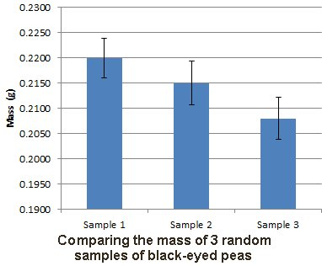
Mean
Sample | Mean (g) | SD | SE | 2 SE
1 | 0.220 | 0.039 | 0.0039 | 0.0078
2 | 0.215 | 0.043 | 0.0043 | 0.0086
3 | 0.208 | 0.042 | 0.0042 | 0.0084
Bar graph with 1 SE bars inserted

Slide 7
Mean
Sample | Mean (g) | SD | SE | 2 SE
1 | 0.220 | 0.039 | 0.0039 | 0.0078
2 | 0.215 | 0.043 | 0.0043 | 0.0086
3 | 0.208 | 0.042 | 0.0042 | 0.0084
Bar graph with 2 SE bars inserted?

Slide 8
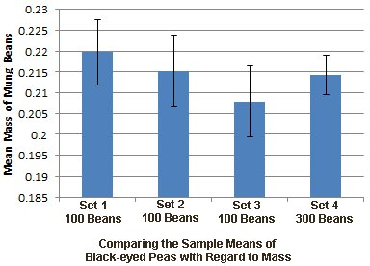
Mean
Adding a mean from a sample size of 300 beans.
Notes:
Point out what happens to the SE bars. With a larger sample size, you increase the probability of capturing the actual mean.

Slide 9
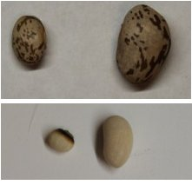
Comparing the Mass of Pinto Beans and Black-eyed Peas
A student was interested in determining if the mass of pinto beans was significantly larger than the mass of black-eyed peas. It is obvious that the mass can vary.

Slide 10
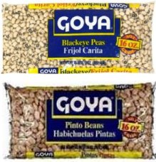
Comparing the Mass of Pinto Beans and Black-eyed Peas
Upon a cursory inspection, it appears that pinto beans are larger but it needs to be quantified. The mass of 300 random seeds are measured and recorded and histograms are made.

Slide 11
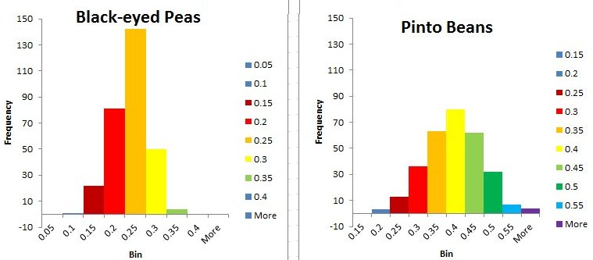
 | Mean | s | SE | 2 SE
Black-eyed Peas | 0.21 | .042
Pinto Beans | 0.37 | .074
Which sample of seeds will have a larger standard deviation, the pinto beans or black-eyed peas?
Notes:
Point out what happens to the SE bars. With a larger sample size, you increase the probability of capturing the actual mean.

Slide 12
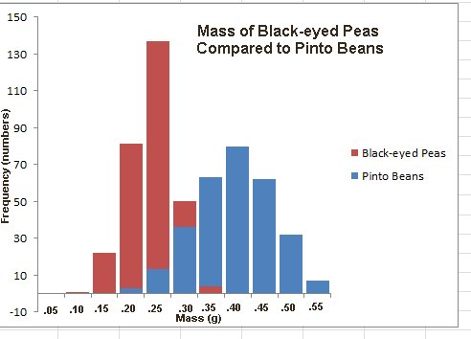
The mean for the black-eyed peas is 0.21 g and the mean for pinto beans is 0.37 g. Remember this only a sample of a larger population.
Notes:
Point out what happens to the SE bars. With a larger sample size, you increase the probability of capturing the actual mean.

Slide 13
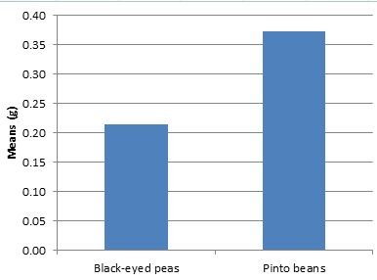
Bar Graph of the Means
 | Mean | SD | SE | 2 SE
Black-eyed Peas | .0.21 | .074 | .0043 | .0086
Pinto Beans | .037 | .041 | .0024 | .0048
Is the difference in the means of these two samples significant?
Notes:
Point out what happens to the SE bars. With a larger sample size, you increase the probability of capturing the actual mean.

Slide 14
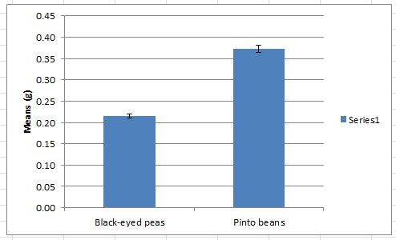
The 2 SE bars do not overlap, so it is most likely that the difference between the mass means is significant.
Notes:
Point out what happens to the SE bars. With a larger sample size, you increase the probability of capturing the actual mean.

Slide 15
Standard Deviation or Standard Error of the Means Bars????
If you are trying to support or reject a hypothesis -- in other words, when you are reporting on the results of an experiment -- you will most likely be using standard error of the means (usually 2 SE for a 95% confidence level) for your error bars but if you want to illustrate the variation in the population, you will use standard deviation bars.
Notes:
Point out what happens to the SE bars. With a larger sample size, you increase the probability of capturing the actual mean.

Slide 16
Your Turn
If you are trying to support or reject a hypothesis -- in other words, when you are reporting on the results of an experiment -- you will most likely be using standard error of the means (usually 2 SE for a 95% confidence level) for your error bars but if you want to illustrate the variation in the population, you will use standard deviation bars.
Notes:
Point out what happens to the SE bars. With a larger sample size, you increase the probability of capturing the actual mean.

Slide 17
Your Turn
Trichomes are hairlike outgrowths of the epidermis of plant that are thought to provide protection against being eaten by herbivores (herbivory). In certain plant species, stem trichome density is genetically determined.
To investigate variation in the stem trichome density within the plant species, a student counted the number of trichomes on the stems of six plants in each of three different populations. The student used the data to calculate the mean trichome density (numbers of hairs per square centimeter) for each population. The results are provided in the table below.
TRICHOME DENSITY IN THREE PLANT POPULATIONS
(number of trichomes/cm²)
Population | Plant 1 | Plant 2 | Plant 3 | Plant 4 | Plant 5 | Plant 6 | Mean | Standard Error of the Mean (SEM)
I | 8 | 11 | 9 | 10 | 8 | 6 | 9 | 1
II | 12 | 6 | 15 | 9 | 13 | 8 | 11 | 1
III | 13 | 17 | 9 | 14 | 12 | 16 | 14 | 1

Slide 18
Your Turn
On the axes provided, create an appropriately labeled graph to illustrate the sample means of the three population to within 95% confidence (i.e. + 2 SEM).
Based on the sample means and standard errors of the means identify the two populations that are most likely to have statistically significant difference in the mean stem trichome densities. Justify your response.
TRICHOME DENSITY IN THREE PLANT POPULATIONS
(number of trichomes/cm²)
Population | Plant 1 | Plant 2 | Plant 3 | Plant 4 | Plant 5 | Plant 6 | Mean | Standard Error of the Mean (SEM)
I | 8 | 11 | 9 | 10 | 8 | 6 | 9 | 1
II | 12 | 6 | 15 | 9 | 13 | 8 | 11 | 1
III | 13 | 17 | 9 | 14 | 12 | 16 | 14 | 1

Slide 19
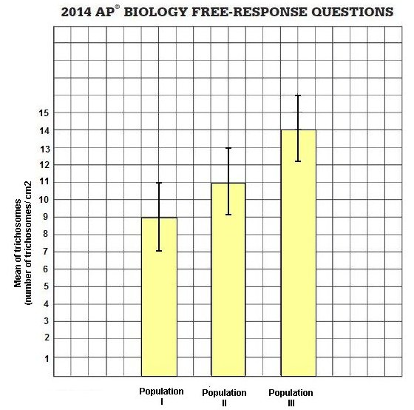
Your Turn

Slide 20
Your Turn
c) Describe the independent and dependent variable and a control treatment for an experiment to test the hypothesis that higher trichome density in plant is selected for in the presence of herbivores. Identify an appropriate duration of the experiment to ensure that natural selection measured and predict the experiment results that would support the hypothesis.
TRICHOME DENSITY IN THREE PLANT POPULATIONS
(number of trichomes/cm²)
Population | Plant 1 | Plant 2 | Plant 3 | Plant 4 | Plant 5 | Plant 6 | Mean | Standard Error of the Mean (SEM)
I | 8 | 11 | 9 | 10 | 8 | 6 | 9 | 1
II | 12 | 6 | 15 | 9 | 13 | 8 | 11 | 1
III | 13 | 17 | 9 | 14 | 12 | 16 | 14 | 1

