Slide 1
The Leading Causes of Mortality
Information from: https://www.proclinical.com/blogs/2017-5/the-leading-causes-of-death-in-the-world-can-they-be-cured

Slide 2
1.) Ischemic heart disease (coronary artery disease)
Also known as coronary artery disease
Nearly 9 million deaths every year
Caused by a build-up of fatty deposits on the wall of the arteries, usually attributed to lifestyle choices or other conditions such as high blood pressure or diabetes.
Arteries become narrowed, restricting blood and oxygen flow to the heart, potentially leading to a fatal heart attack. Non-deadly attacks cause chest pain known as angina, which can proceed a heart attack.
Eastern European countries such as Ukraine, Uzbekistan and Kyrgyzstan suffer the highest number of casualties, most likely due to the heavy drinking culture and high levels of pollution.

Slide 3
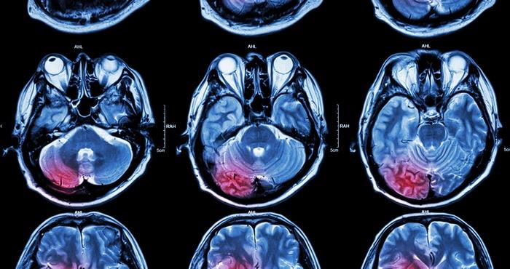
2.) Stroke
A stroke occurs when the blood supply to the brain is disrupted, causing brain cells to die.
This can lead to brain injury, disability and in some cases, death.
The main causes of a stroke are from a blockage/blood clot (ischemic) or a ruptured blood vessel (hemorrhagic).

Slide 4
3.) Lower respiratory infections
Triggered by viruses and bacteria and affect the patient’s lungs and airways
Examples include influenza (the flu), bronchitis and pneumonia.
Global flu epidemics and pneumonia are known to cause devastation in elderly and infant populations every year.
In 2015, pneumonia killed 920,136 children under the age of 5, mostly in South Asia and sub-Saharan Africa. The introduction of vaccines has been incredibly effective in lowering mortality rates over the past 20-30 years, particularly in developing countries.

Slide 5
4.) Chronic obstructive pulmonary disease (COPD)
These include chronic bronchitis and emphysema, which are conditions that make the lungs inflamed and damaged
The main cause is smoking, although COPD can affect non-smokers, particularly asthma patients and those who live in very polluted areas.
Asian populations are most affected because of high levels of pollution in countries such as Nepal, North Korea and India.
COPD is estimated to be the cause of 3.17 million deaths every year.

Slide 6
5.) Lung cancer, trachea and bronchus
Lung disease, particularly lung cancer, is number 5 of the top 10 killers. It is responsible for over 1.6 million deaths worldwide. Lung cancer is a particularly aggressive and serious form of cancer that is very common in smokers, accounting for 85% of cases. Countries such as Spain and Hungary are highly affected by the disease, and in China, it is the most common type of cancer.

Slide 7
6.) Diabetes
Affects over 400 million people, resulting in approximately 1.59 million deaths each year.
There are two types of the disease; one is an autoimmune condition whilst the other is linked to poor lifestyle choices such as diet.
The body has difficulty dealing with insulin, an agent that helps the body to absorb and process glucose.

Slide 8
7.) Alzheimer’s disease
The number of people dying from Alzheimer’s disease, the leading cause of dementia, is rapidly increasing every year (1.54 million).
Alzheimer’s in a neurodegenerative disease in which patients experience a gradual decrease in cognitive ability, such as memory and speech, caused by a build-up of amyloid proteins.
Currently, there is no known way to prevent or cure Alzheimer’s disease.

Slide 9
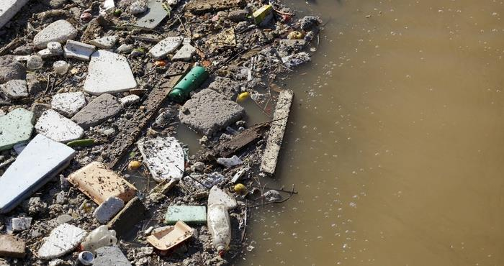
8.) Diarrheal diseases
The second leading cause of death in children under 5 years, killing approximately 525,000 children every year.
Prolonged bouts of diarrhea strip the person of water and vital electrolytes such as sodium and chloride, leading to fatal levels of dehydration and malnutrition.
These diseases are predominantly caused by drinking unclean water and/or living in unsanitary conditions but can be easily treated with medication.
Insufficient availability of these life-saving drugs in many developing countries makes it difficult to control the widespread outbreaks, leading to 1.39 million deaths a year.

Slide 10
9.) Tuberculosis (TB)
It is caused by a bacterial infection.
TB was one of the most prevalent global epidemics in the 18th and 19th centuries.
The widespread distribution of the TB vaccine (BCG) helped to reduce cases, although it has not been entirely effective in preventing the disease.
One-third of the world’s population is infected with TB bacteria every year, causing over 9 million cases and resulting in around 1.4 million deaths.

Slide 11
10.) Road accidents
Tragically, as many as 1.3 million deaths are a result of road accidents every year.
It is the leading cause of accidental death.
Road accidents often lead to death as the impact of a collision can cause severe injuries such as head trauma (brain swelling, haemorrhages and blood clots), external and/or internal bleeding, or a broken neck.
It’s the leading cause of death among those aged 15-30, with 90% of cases occurring in developing countries

Slide 12
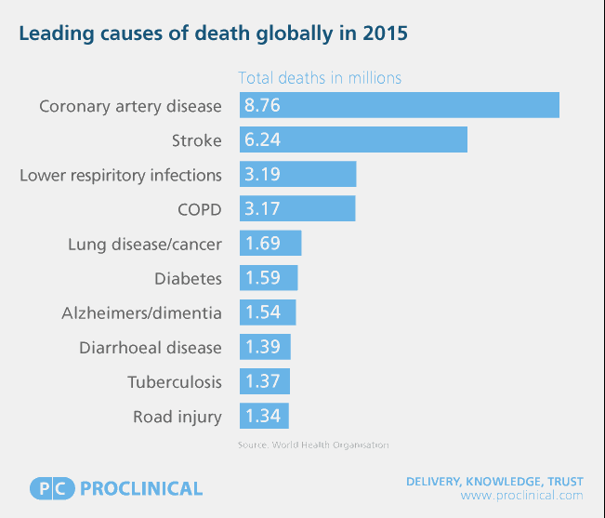

Slide 13
Causes of mortality-LOW vs. HIGH INCOME ECONOMIES DATA FROM THE WORLD HEALTH ORGANIZATION
LOW INCOME ECONOMIES 2015 | HIGH INCOME ECONOMIES 2015
1.) LOWER RESPIRATORY INFECTIONS | 1.) ISCHAEMIC HEART DISEASE
2.) DIARRHEAL DISEASES | 2.) STROKE
3.) STROKE | 3.) ALZHEIMER’S DISEASE AND OTHER DEMENTIAS
4.) ISCHAEMIC HEART DISEASE | 4.) TRACHEA, BRONCHUS, LUNG CANCERS
5.) HIV/AIDS | 5.) CHRONIC OBSTRUCTIVE PULMONARY DISEASE
6.) TUBERCULOSIS | 6.) LOWER RESPIRATORY INFECTIONS
7.) MALARIA | 7.) COLON AND RECTUM CANCERS
8.) PRETERM BIRTH COMPLICATIONS | 8.) DIABETES
9.) BIRTH ASPHYXIA AND BIRTH TRAUMA | 9.) KIDNEY DISEASE
10.) ROAD INJURY | 10.) BREAST CANCER

