Slide 1
TRANSCRIPTION AND TRANSLATION

Slide 2
The Central Dogma of Biology
DNA→ RNA→ Protein→ Traits

Slide 3
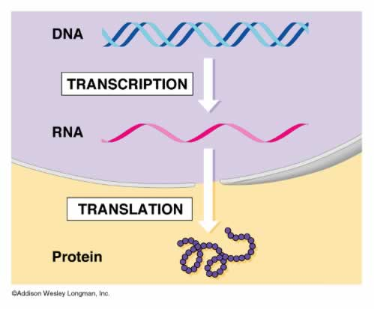
NUCLEUS→
CYTOPLASM→

Slide 4
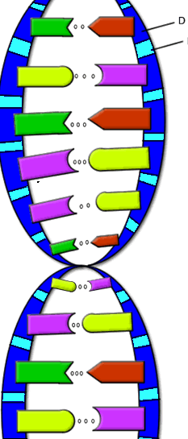
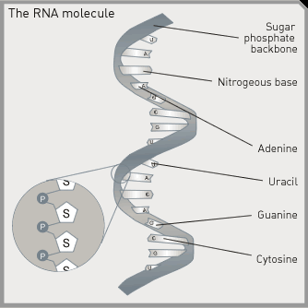
RNA vs. DNA
DNA
Double stranded
Deoxyribose sugar
Bases: C,G A,T
Monomer: nucleotide
RNA
Single stranded
Ribose sugar
Bases: C,G,A,Uracil
Monomer: nucleotide
Both contain a sugar, phosphate, and base.

Slide 5
Transcription-occurs in the nucleus
RNA forms base pairs with DNA
C-G
A-U
Messenger RNA (mRNA) is the end product of transcription
It exits the nucleus through a nuclear pore and enters the cytoplasm
It exits the nucleus through a nuclear pore and enters the cytoplasm

Slide 6
Transcribe the following sequence:
TAC GTT AAA CGC TAT
AUG CAA UUU GCG AUA
mRNA is read in triplets called CODONS
http://www.dnatube.com/video/3450/DNA-Transcription

Slide 7
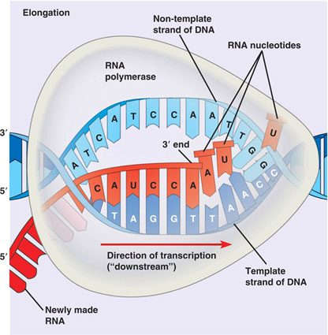

Slide 8
ANIMATIONS
http://www.stolaf.edu/people/giannini/flashanimat/molgenetics/transcription.swf
http://www.dnalc.org/resources/3d/13-transcription-advanced.html
http://vcell.ndsu.edu/animations/transcription/movie-flash.htm

Slide 9
Transcription is done…what now?
Now we have mature mRNA transcribed from the cell’s DNA. It is leaving the nucleus through a nuclear pore. Once in the cytoplasm, it finds a ribosome so that translation can begin.
We know how mRNA is made, but how do we “read” the code?

Slide 10
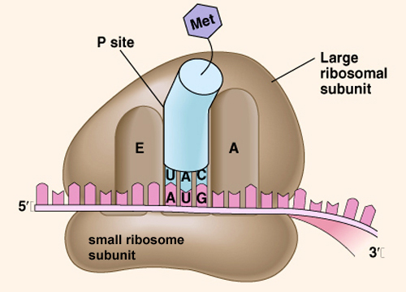
Ribosomes-make protein (in the cytoplasm)!
2 subunits, separate in cytoplasm until they join to begin translation
Large
Small
Made of rRNA (ribosomal RNA)
and protein
Contain 3 binding sites
E
P
A

Slide 11
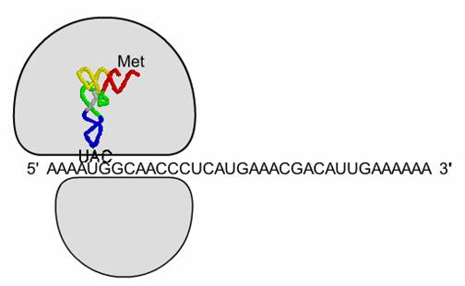
Translation-in the cytoplasm!
Second stage of protein production
mRNA is on a ribosome
tRNA (transfer RNA) brings amino acids to the ribosome

Slide 12
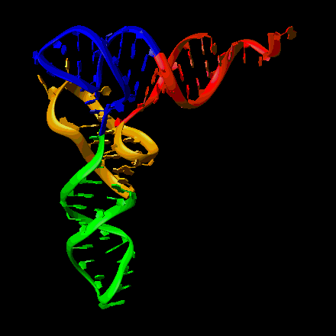
tRNA (transfer RNA)
Bound to one amino acid on one end
Anticodon on the other end complements mRNA codon

Slide 13
tRNA Function
Amino acids must be in the correct order for the protein to function correctly
tRNA lines up amino acids using mRNA code

Slide 14
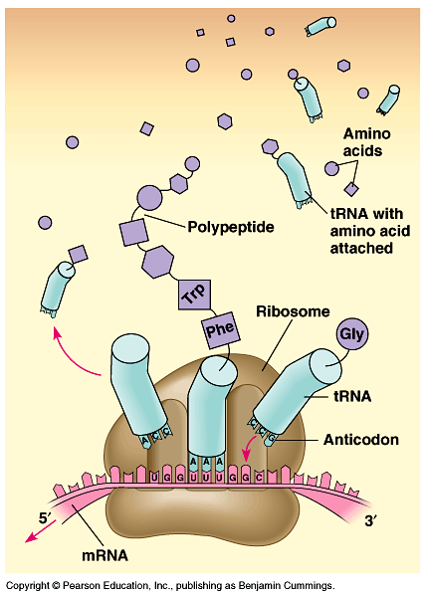
http://vcell.ndsu.nodak.edu/animations/translation/movie-flash.htm

Slide 15
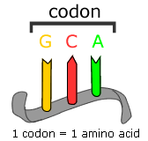
Reading the DNA code
Every 3 DNA bases pairs with 3 mRNA bases
Every group of 3 mRNA bases encodes a single amino acid
Codon- coding triplet of mRNA bases

Slide 16
The Genetic Code-The Codon Chart

Slide 17
ACGATACCCTGACGAGCGTTAGCTATCG
UGC
UAU
GGG
ACUG

Slide 18
Transcription vs. Translation Review
Transcription
Process by which genetic information encoded in DNA is copied onto messenger RNA
Occurs in the nucleus
DNA → mRNA
Translation
Process by which information encoded in mRNA is used to assemble a protein at a ribosome
Occurs in the cytoplasm on a Ribosome
mRNA → protein

